Slide 1
Achieving a Smooth Ride by Automated
Machine Guidance
Ryan Darling & David Hosking, Construction and Materials Bureau
Matthew Bogaczyk, Project Delivery Bureau

Slide 2
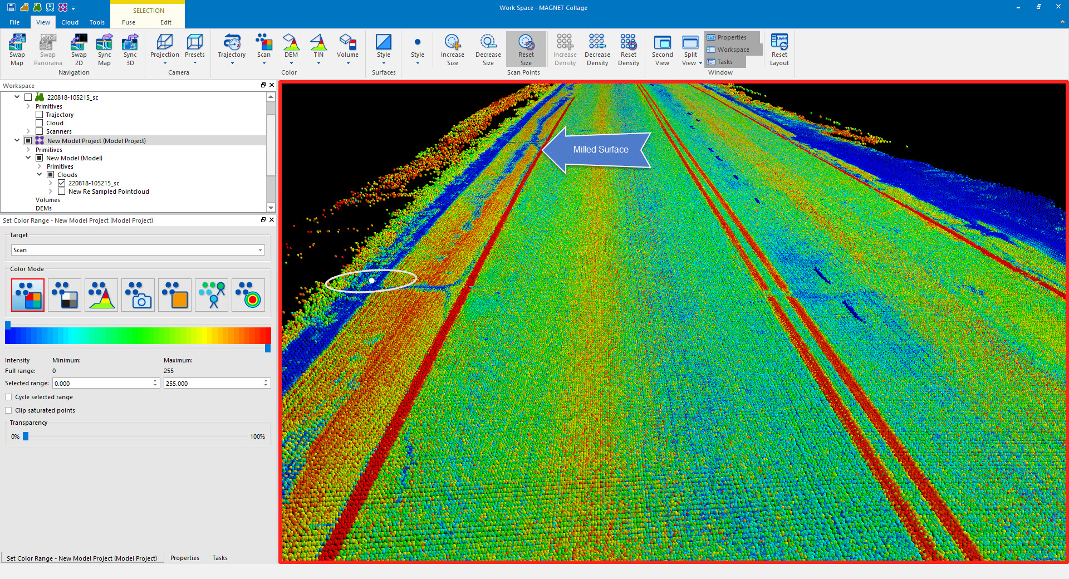
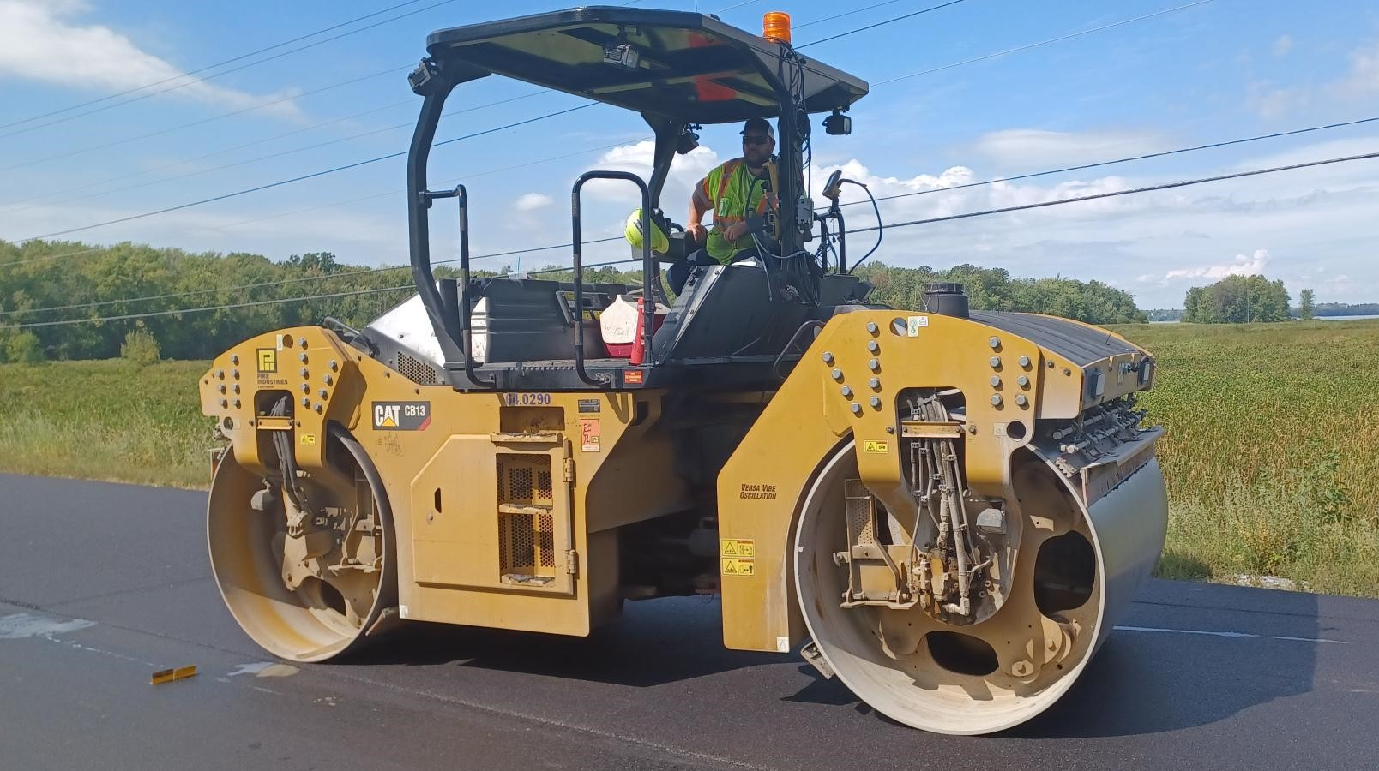
SmoothRide Solution
Topcon’s All‐inclusive Road Resurfacing System
Pre & Post Scanning by LIDAR (RD-M1 Scanner) | MAGNET Design & Collage Software | 3D Machine Control Milling and Paving (RD-MC) | Intelligent Compaction (C-63 Intelligent Compaction System)

Slide 3
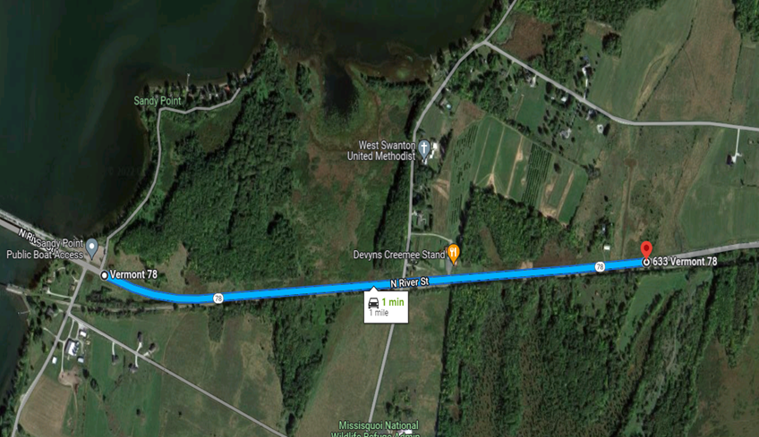
Project & Demonstration Selection
Swanton NH FPAV (58)
6 Mile 1.5” Mill & Fill on VT 78
Project Status: In Construction - Started 5/19/22
Geography: Flat & Open Canopy
Remote Location
Selected by Contractor Approved by Engineer
Min. 1-mile required
Worst condition of project
  Average IRI: 156 in/mi Rut Depth: 4”
  No network coverage. Base station & GNSS receiver used for communication

Slide 4
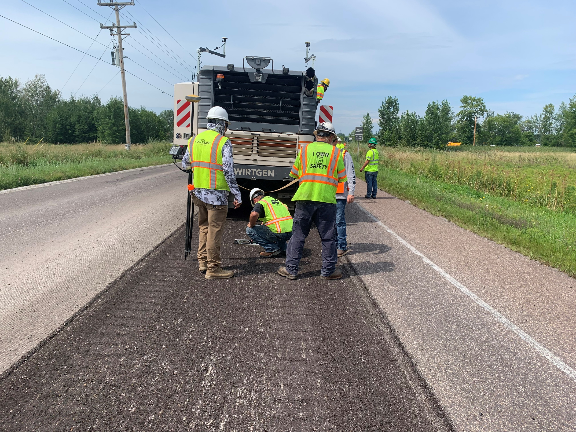
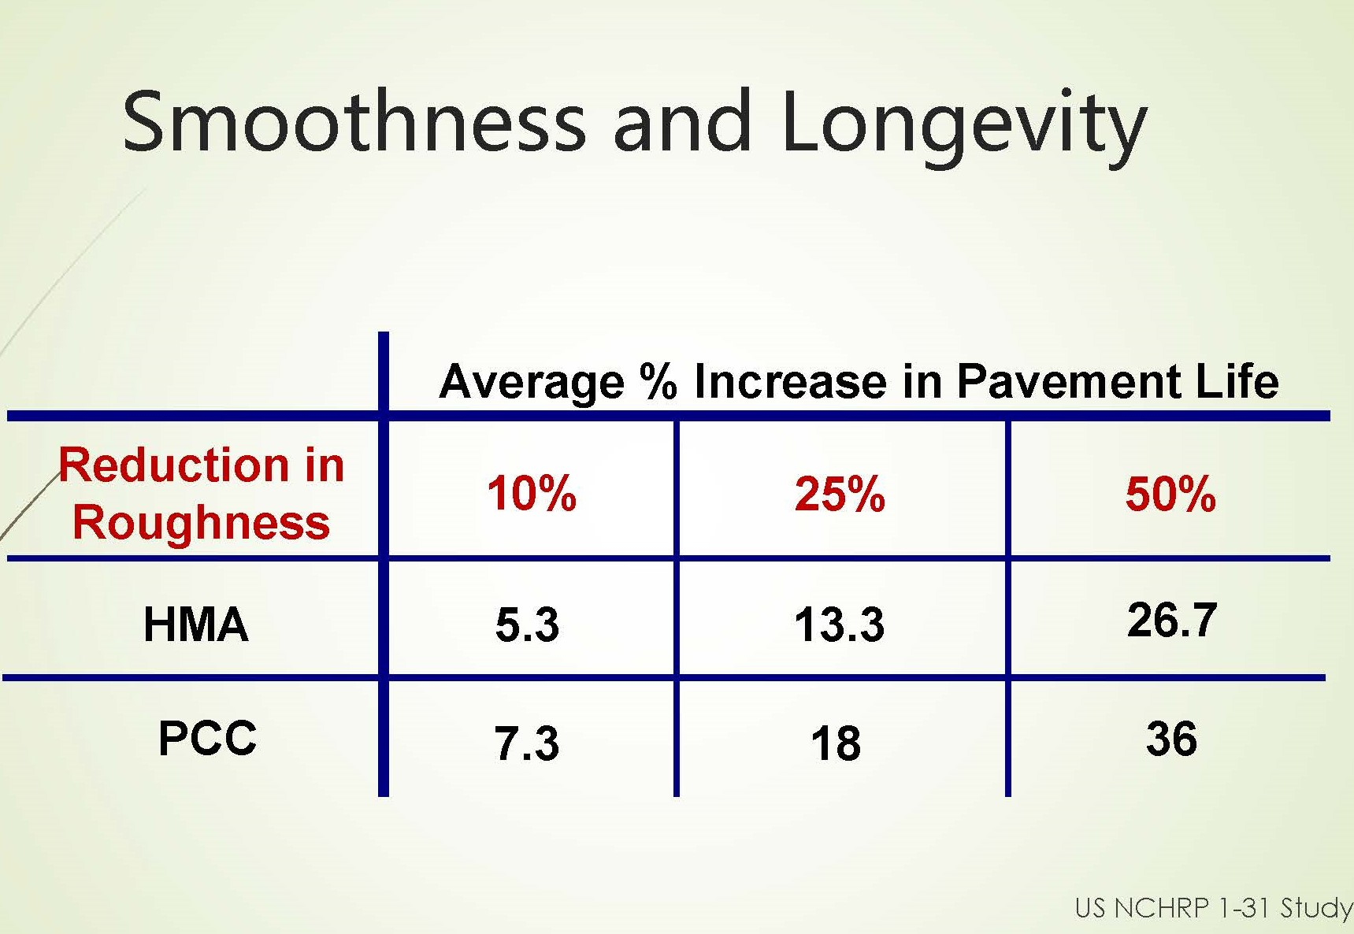
Purpose of Demonstration
Comparison of SmoothRide vs. conventional construction methods
New technology and digital as-builts in the Agency and contractor's hands
Improve resurfacing quality with limited scope of work
  Preliminary road scans
  Operate from Model of Record
  Intelligent Compaction
Extend the life of the project
  Typical Life Expectancy: 5-8 years
Future use of Automated Machine Guidance specifications

Slide 5
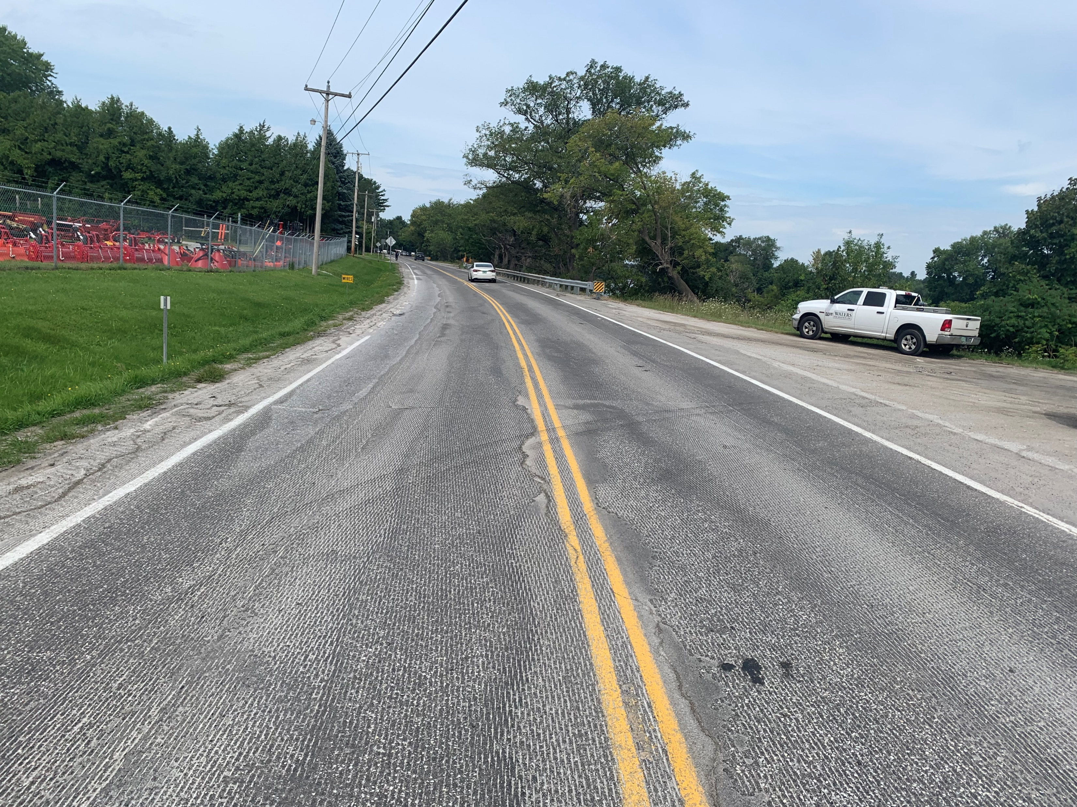
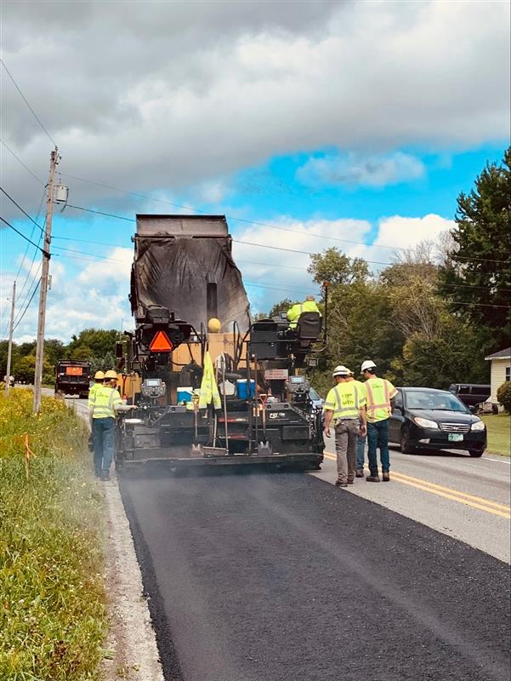
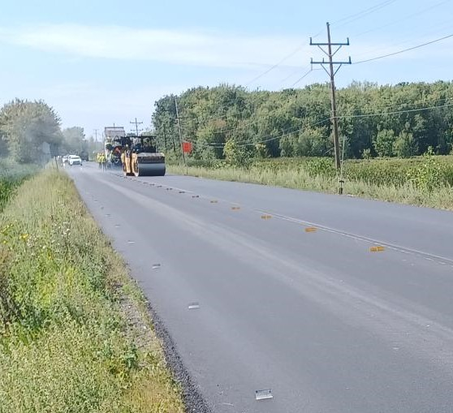
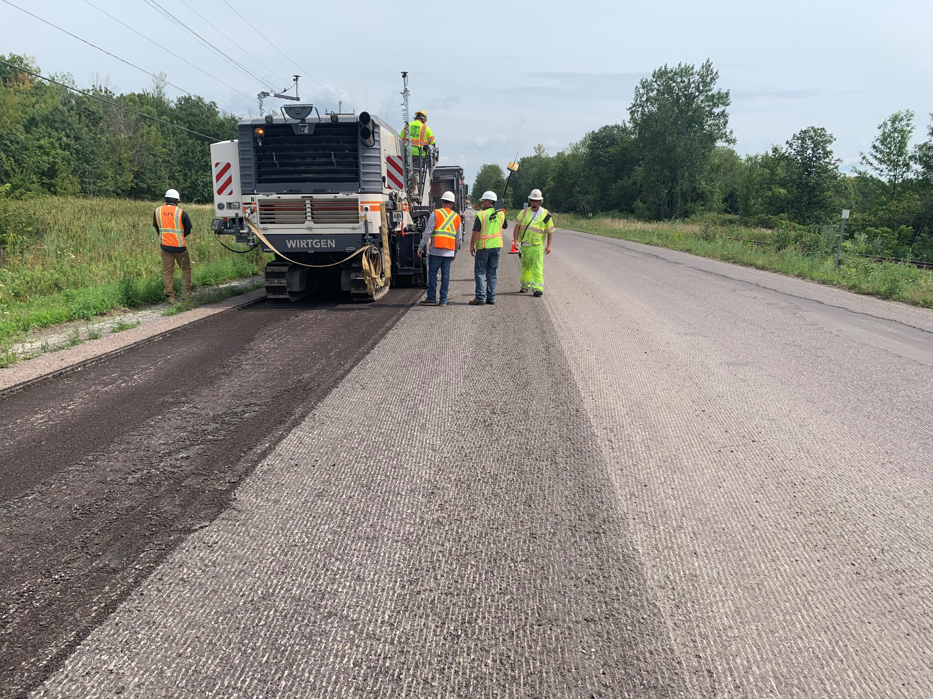
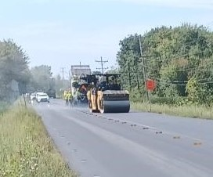
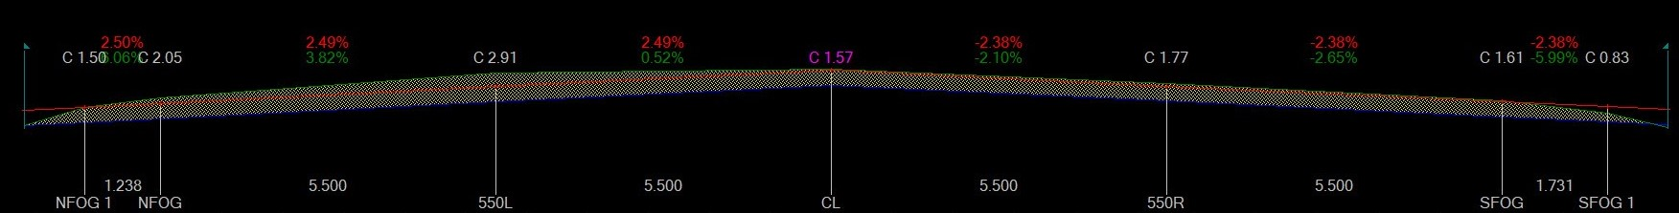
Results
Conventional Methods
Quality Improvements:
VTrans Surface Testing:
  SmoothRide: Pre IRI: 158 in/mi vs. Post IRI: 52 in/mi = 67% imp.
  Conventional: Pre IRI: 150 in/mi vs. Post IRI: 60 in/mi = 60% imp.
Preliminary SmoothRide Scan: Mill depth range: 0”‐ 3.5”
Post SmoothRide Scan: Actual tolerance: 0.01” from design. Profile paving not necessary.
No spot shim needed with SmoothRide. 280 ton/mi for conventional section. (1,400 ton for 5 miles)
3 Investigative cores taken from each method.
  SmoothRide Average: 92.0% Comp.
  Conventional Average: 92.7% Comp.
Time & Manpower Savings:
SmoothRide 3D survey obtained by 2 personnel at 2 hours for each scan vs. Typical 2D design data generated in 5 days by design team.
Increased Safety:
SmoothRide Scan performed from the vehicle at highway speeds vs. design and inspection team working in live traffic to establish baseline and initial survey.
SmoothRide Solution

Slide 6
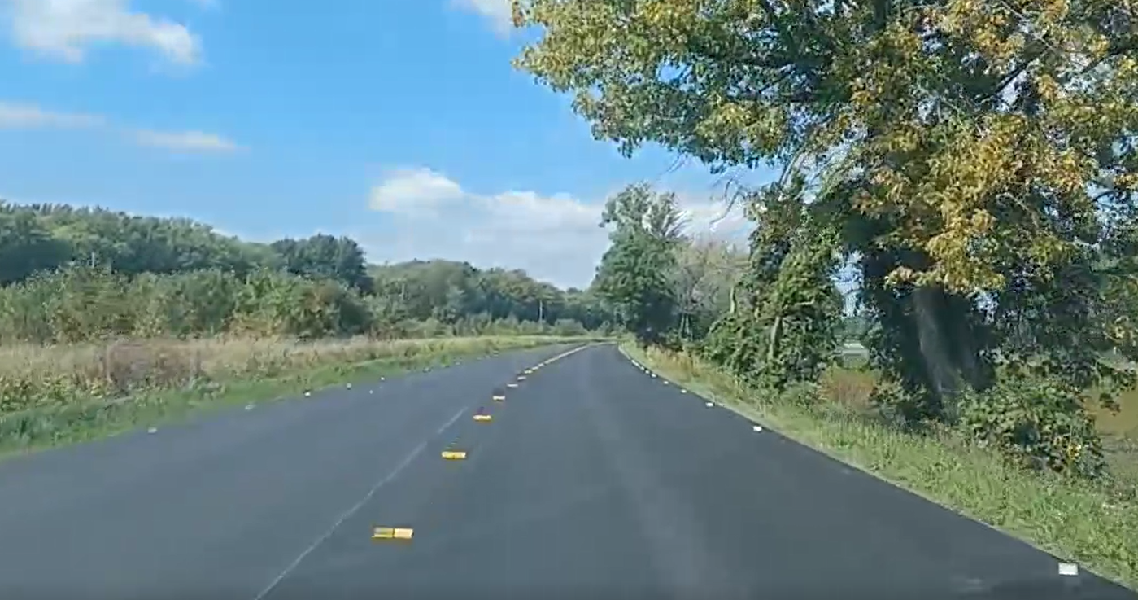
Conclusion
SmoothRide provided a 14% reduction in roughness over conventional construction methods
  An 8% average increase in pavement life may provide up to one additional year of service life prior to rehabilitation.
Successful demonstration with VTrans & Industry working together to implement new technology
Topcon performed a free demonstration of their SmoothRide Solution
  Estimated equipment costs: $200,000 including surface scanner and RD-MC for Mill and Paver Optional $50,000 for GNSS receiver, RTK Base, and Rover.
  Conventional section: 280 ton/mi of spot shim needed in Estimated at $30,000/mi
Topcon Support:
  Excellent guidance
  Technical and field support
  Field verified their solution worked in the field
SmoothRide Benefits:
  Construction to be completed on time and on budget
  Improves work zone safety
  Extends the life of the resurfacing treatment
Created specifications for Automated Machine Guidance System and will review specification to allow for other makes and models.
Possible projects candidates include resurfacing projects, mill and fill projects, profile milling ahead of cold and hot in-place recycling projects.

