Slide 1
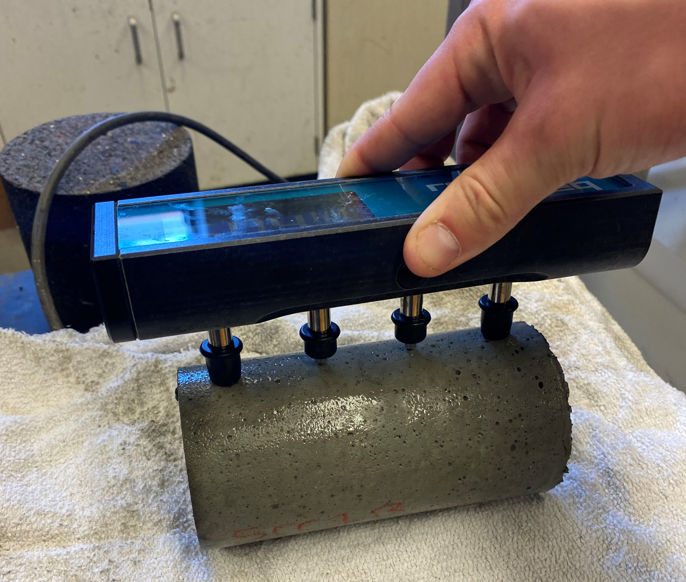
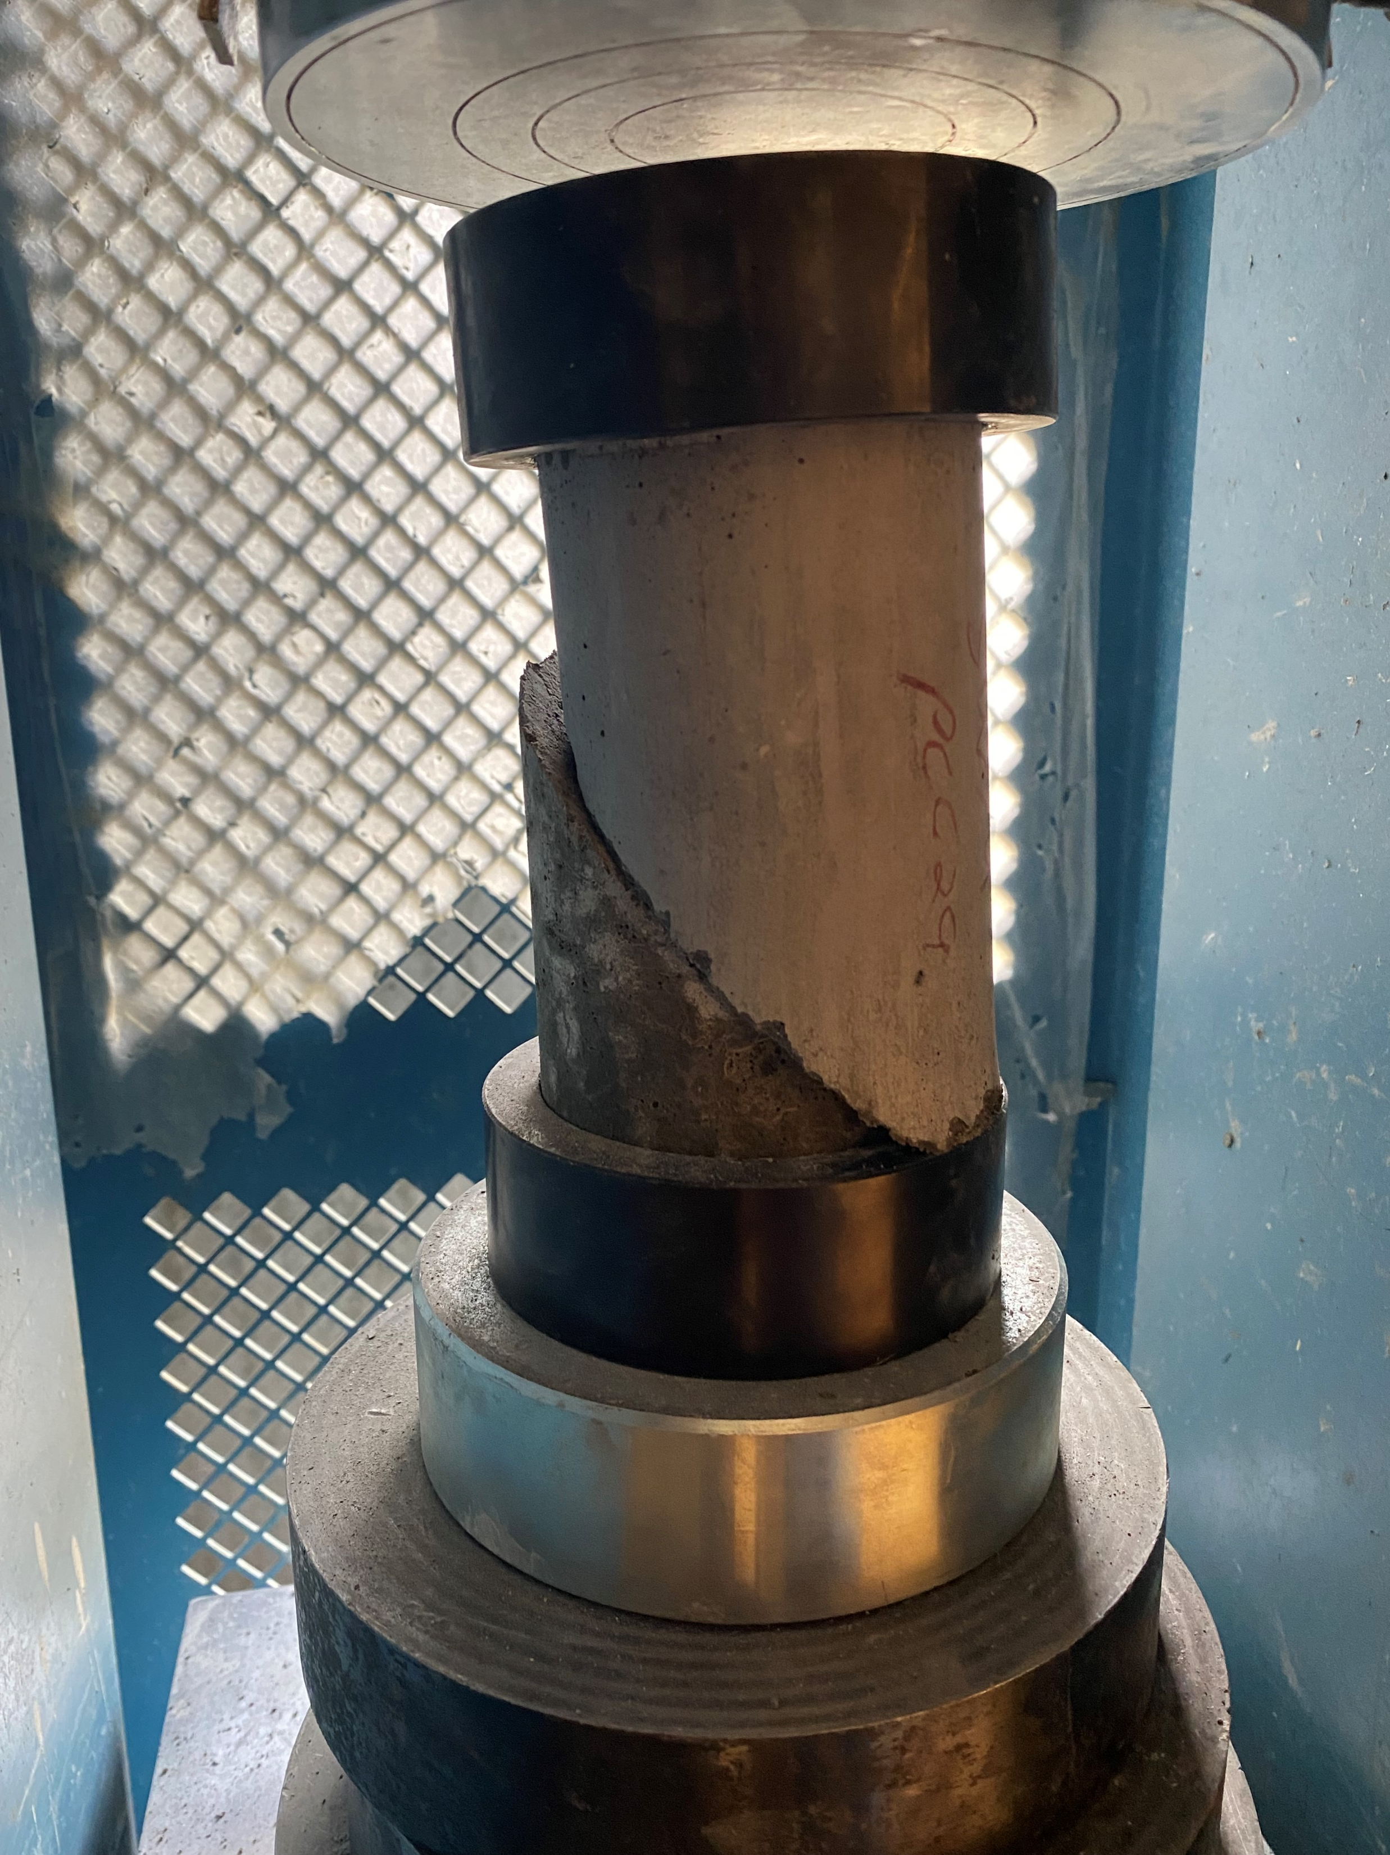
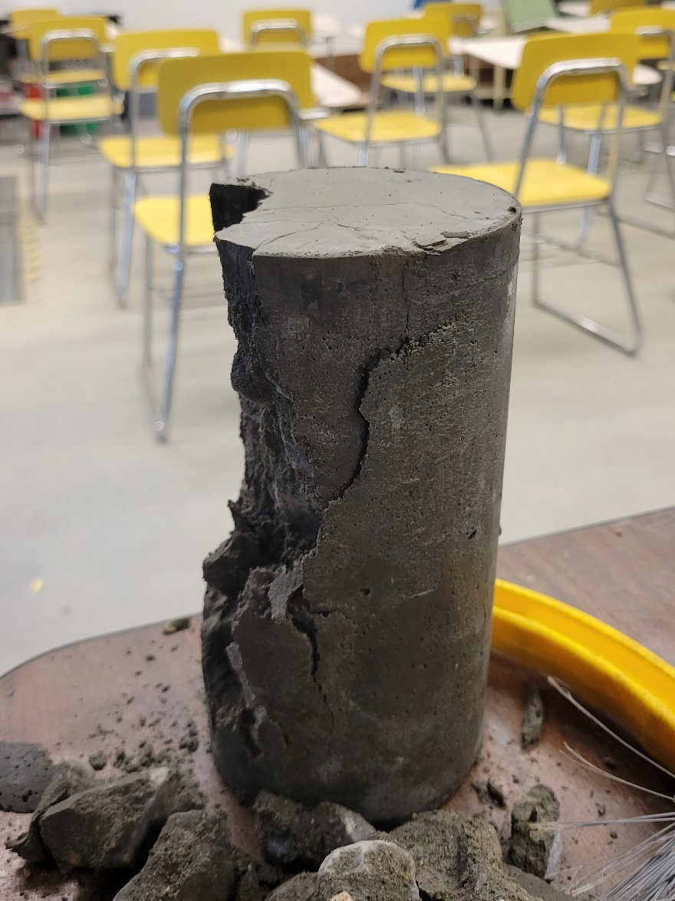
Development of Cost-Effective Rapid-Setting Concrete for Improved Bridge Joint Performance
Eshan V. Dave, Jo E. Sias, Saeed (Yashar) Eftekhar Azam, Spencer McKinnon
Department of Civil and Environmental Engineering, University of New Hampshire
Research Need and Problem Statement
Field placed rapid setting concrete (RSC) connections are often considered “weak links” in accelerated bridge construction (ABC).
Current specification for RSC are usually fully performance based. Standardized mix designs or hybrid performance and proportion-based designs can improve economics.
There is a lack of previous studies that have conducted durability testing on RSC used in ABC connections.
Due to durability concerns of RSC, membranes and bituminous overlays are currently required on VAOT ABC projects, these increase construction and maintenance costs.
Select Data and Results
Multivariate analysis was conducted on all laboratory test results. Pearson’s correlation matrix was developed to compare all compositional parameters with performance parameters. Total cementitious content and percent Portland cement replacements by SCM were found to be strongly correlated to most performance parameters. Improved bond strength for higher SCM content materials, while lower surface resistivity (higher chloride permeability) potential.
Figure 1. Accelerated Bridge Construction with Field Placed RSC Connections.
Methodology
A comprehensive state-of-the-art and state-of-the-art review was conducted, this was used to develop two phased experimental plans to assess durability of RSC used by VAOT in recent ABC projects and to develop a hybrid proportion and performance-based material specifications. Two phased laboratory experimentation was conducted (phase-I used partial factorial based on recently used RSC on VAOT projects and phase-II conducted a full-factorial evaluation.
Figure 3. Select Laboratory Testing Results (left to right: compressive strength change with total cementitious content, effect of freeze-thaw conditioning on surface resistivity for different Portland cement replacement percentages, and effect of freeze-thaw conditioning on compressive strength).
Conclusions
The main outcome of this study is that the current RSC materials used by VAOT have very high durability and they do not warrant need for membrane treatments on ABC projects. Further, a hybrid proportion and performance-based specification are recommended that are expected to lower costs and testing requirements associated with future RSC materials used by the agency.
Future efforts should be undertaken to extend the findings of this research to consider moment transfer along field placed connections of ABC and to conduct field evaluations of this project’s recommendations.
State of the art and practice review
Experimental design & materials selection
Laboratory experimentation
Data (statistical) analysis
Develop recommendations
Figure 3. Select Laboratory Tests (Clockwise from top left: surface resistivity, slant shear bond, compressive strength and freeze- thaw conditioning tests)
Acknowledgments
The research team would like to sincerely acknowledge the support of the project panel and specifically of Mr. Jim Lacroix for his inputs. Research team also acknowledges donations of aggregates from various Vermont aggregate producers. Lastly, research team acknowledges continuous support and help of the VAOT Research staff.
Figure 2. Research Approach

