Slide 1

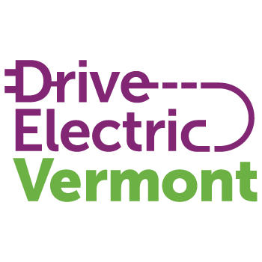
Planning for Electric Vehicle Charging Infrastructure in Vermont
May 18th| 1:00 pm – 3:00 pm
Notes:
Peggy: Slides 1-4

Slide 2
Agenda
1:00 – Welcome and Introductions
1:05 – Charging infrastructure overview
1:15 – Vermont charging investments to-date
1:30 – Federal and State goals for EV charging
1:40 – Vermont EV charging plan development
1:55 – break
2:00 – break-out rooms to discuss feedback
2:20 – break-out reports
2:30 – open discussion / Q&A

Slide 3
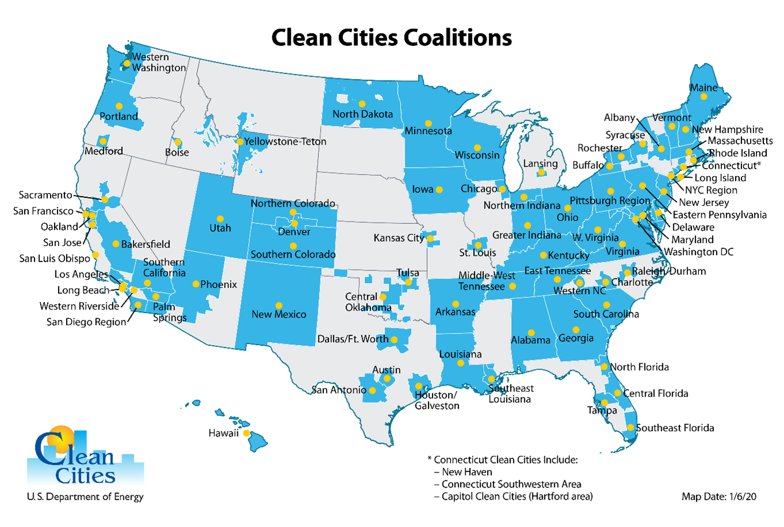
National Network of Clean Cities Coalitions
Nearly 80 Clean Cities coalitions with thousands of stakeholders, representing ~80% of U.S. population
Three Clean Cities Coalitions in Northern tier of New England: Vermont, Granite State & Maine
We foster economic, environmental & energy security of the US by working locally to advance affordable, domestic transportation fuels, energy efficient mobility systems, & other fuel-saving technologies and practices
Notes:
Peggy: Slides 1-4
More than 80% of the U.S. population lives inside Clean Cities coalition boundaries. An active and diverse network of nearly 16,000 stakeholders—government agencies, industry representatives, community organizations, and businesses—work through Clean Cities to exchange information and resources. 43% of these stakeholders come from the private sector while the other 57% represent the public sector. Through our collective efforts we are transforming local and regional transportation markets.
Across the country, local coalitions serve as the foundation of this network by working in communities to:
Increase energy savings from efficiency projects, measured in gasoline gallon equivalents
Increase resiliency through fuel diversity with alternative fuels.
Each coalition is led by an on-the-ground Clean Cities coordinator [like me] who tailors projects and activities to capitalize on the unique opportunities in their region. Coordinators serve as both educators and problem solvers for their stakeholders. Coalitions are locally-based with access to national resources.

Slide 4
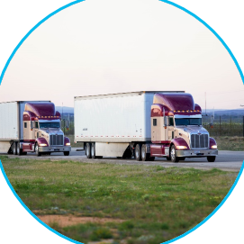
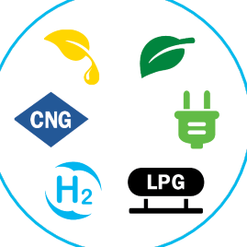
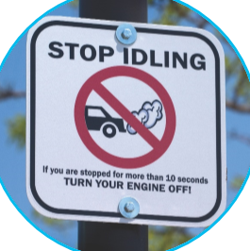
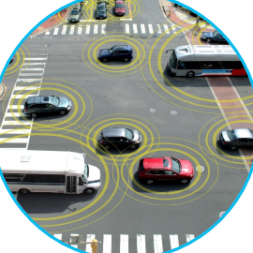
Clean Cities Portfolio
Light-, Medium-, and Heavy-Duty Vehicles
Alternative and Renewable Fuels and Infrastructure
Idle Reduction Measures and Fuel Economy Improvements
New Mobility Choices and Emerging Transportation Technologies
Notes:
Clean Cities coalitions employ a portfolio of strategies to advance affordable, domestic transportation fuels and energy-saving technologies:
Evaluate transportation needs and energy choices to determine the most impactful and cost-effective vehicle options, fuels, technologies, and best practices that make sense for specific stakeholder applications
Shift to domestic energy sources through the use of alternative and renewable fuels such as natural gas, propane, hydrogen, electricity, ethanol, and biodiesel
Improve fuel efficiency through state-of-the-art technologies and strategies
Reduce harmful emissions through idle reduction and other fuel-saving technologies and practices
Demonstrate and assess new mobility choices that maximize the return on investment for mobility systems in terms of time, cost, energy, and opportunity.

Slide 5
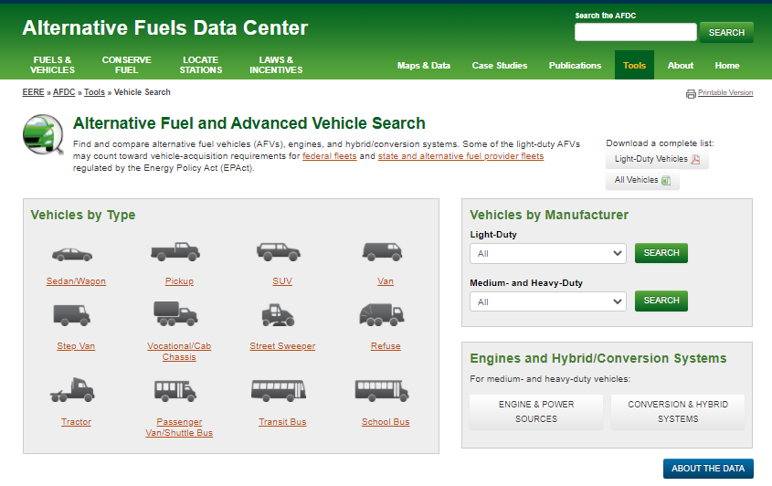
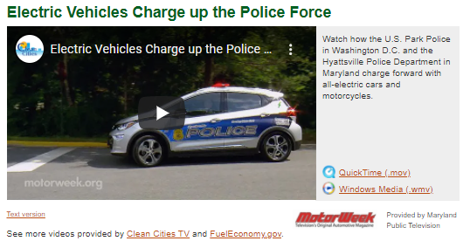
References and Resources
AFDC Laws & Incentives:
  https://afdc.energy.gov/
AFDC Case Studies:
  https://afdc.energy.gov/case/
AFDC Vehicle Search Tool:
  https://afdc.energy.gov/vehicles/search/
AFLEET – Calculate Cost of Ownership:
  https://greet.es.anl.gov/afleet
Notes:
AFDC Alternative Fuel and Advanced Vehicle Search (http://www.afdc.energy.gov/vehicles/search)
AFDC Station Locator Database (http://www.afdc.energy.gov/locator/stations/)
FuelEconomy.gov’s Alternative Fuel Vehicles (AFV) page (http://www.fueleconomy.gov/feg/alternatives.shtml)
Clean Cities 2015 Vehicle Buyer’s Guide (http://www1.eere.energy.gov/cleancities/publications.html)

Slide 6
Polls
1. Are you representing an organization?
2. Have you ever driven an EV?
3. Have you ever used public EV charging?

Slide 7
Planning for Electric Vehicle Charging Infrastructure in Vermont
VERMONT Clean Cities Coalition, May 18, 2022
Dave Roberts, Managing Consultant, VeIc & Drive Electric Vermont
Patrick Murphy, Sustainability & Innovations Project Manager, VT Agency of Transportation

Slide 8
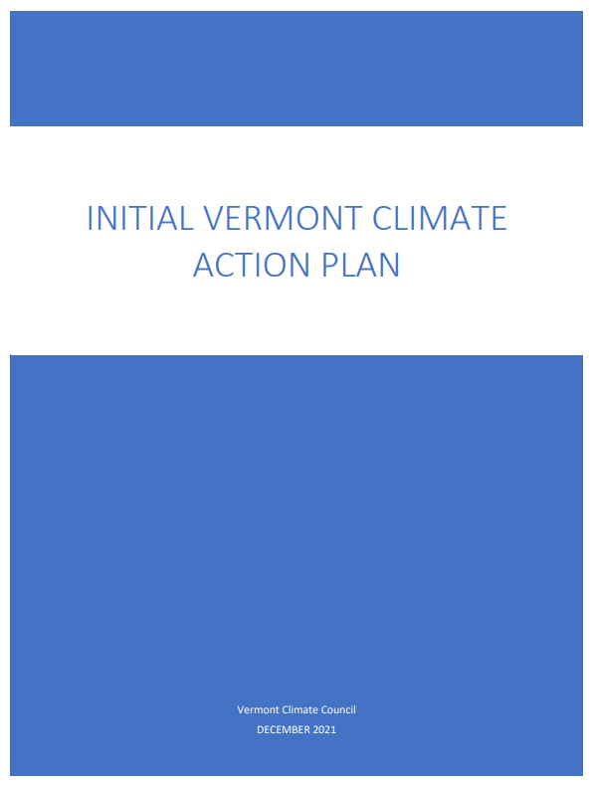
Climate Action Plan
Initial plan finalized in December 2021
EV Adoption scenarios :
  27,000 PEVs by 2025 (17% of sales)
  126,000 PEVs by 2030 (68% of sales)
Reduce GHG emissions below 2005 GHG emissions in Vermont by no less than 26% below 2005 GHG emission levels by January 1, 2025;
by no less than 40% below 1990 GHG emission levels by January 1, 2030;
and no less than 80% below 1990 GHG emission levels by January 1, 2050.
05/18/2022
https://climatechange.vermont.gov/

Slide 9
CAP – Pathway 1 – Light Duty Electrification Strategies
Technology Forcing ZEV Regulation (100% by 2035)
EV Purchase Incentives
  New & used EVs and electric bicycles, designed for equity
  Expand to fleets
  Continue MileageSmart and Replace Your Ride
  Vehicle Efficiency Purchase and Use Tax Adjustment
EV Charging Investment
  Continue support for DCFC and Level 2
  Public, workplace and multifamily priorities
  Direct the PUC to consider EV charging rates
Transportation Climate Initiative (TCI)
EV and VMT reduction Outreach and Education
Electrify 27,000 light duty vehicles by 2025
126,000 by 2030
05/18/2022
VERMONT ELECTRIC VEHICLE & INFRASTRUCTURE PROGRAMS

Slide 10
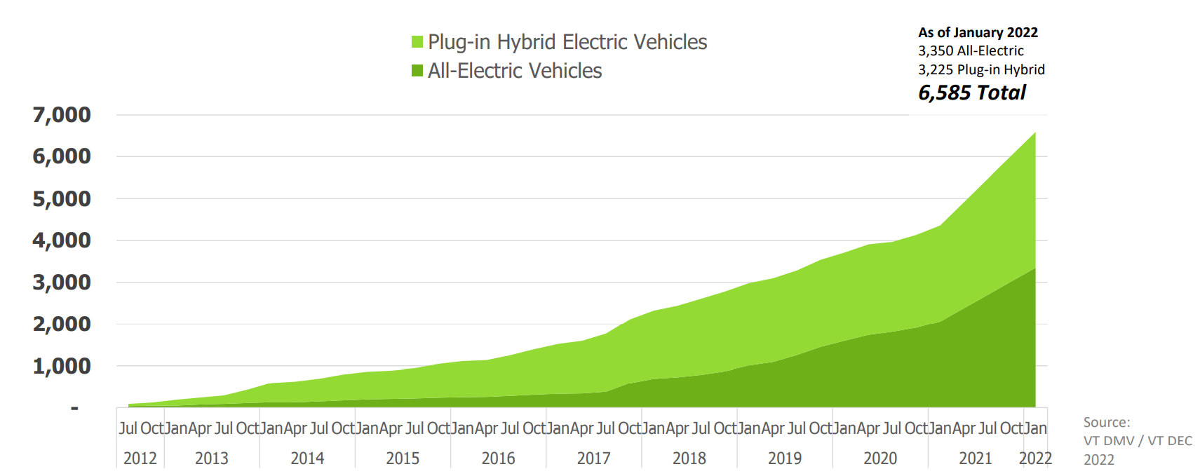
EV Adoption in Vermont

Slide 11
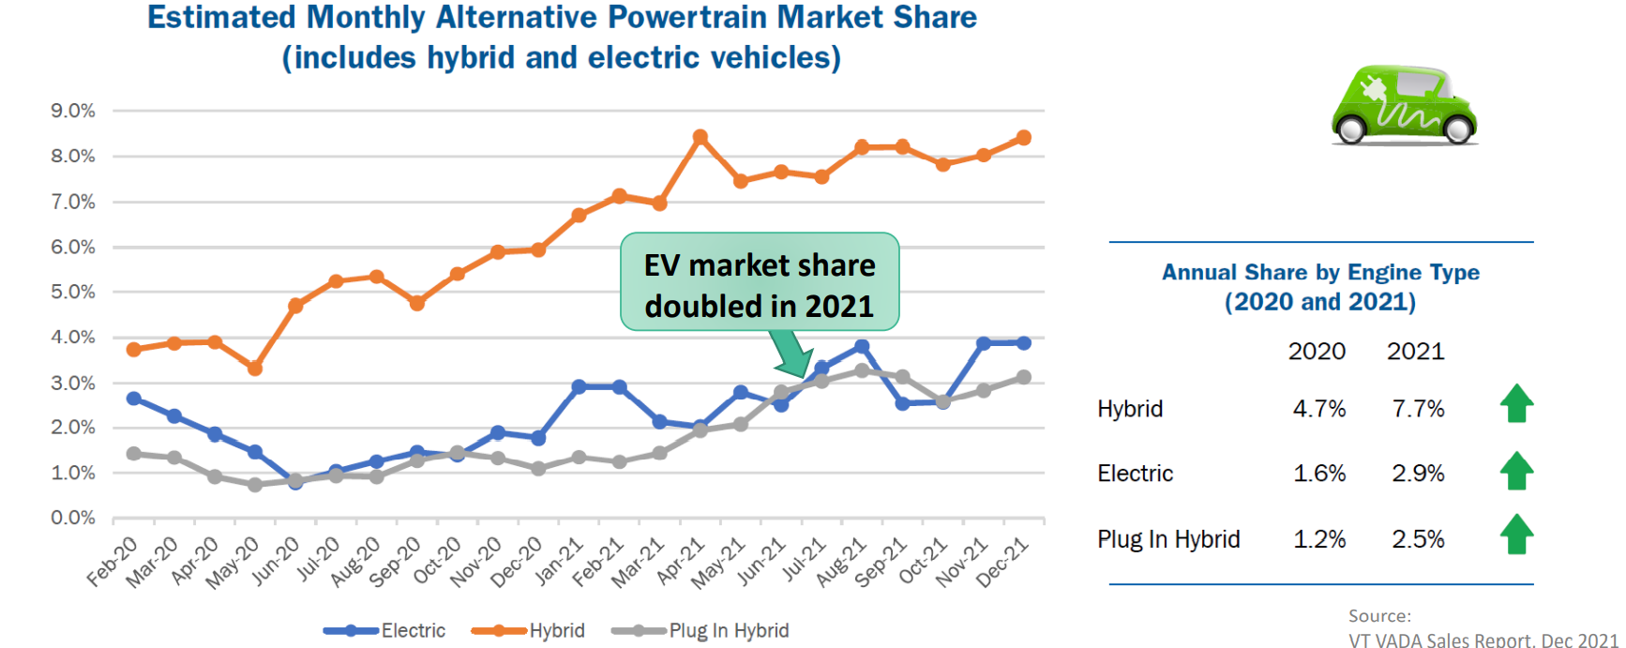
EV Adoption in Vermont

Slide 12
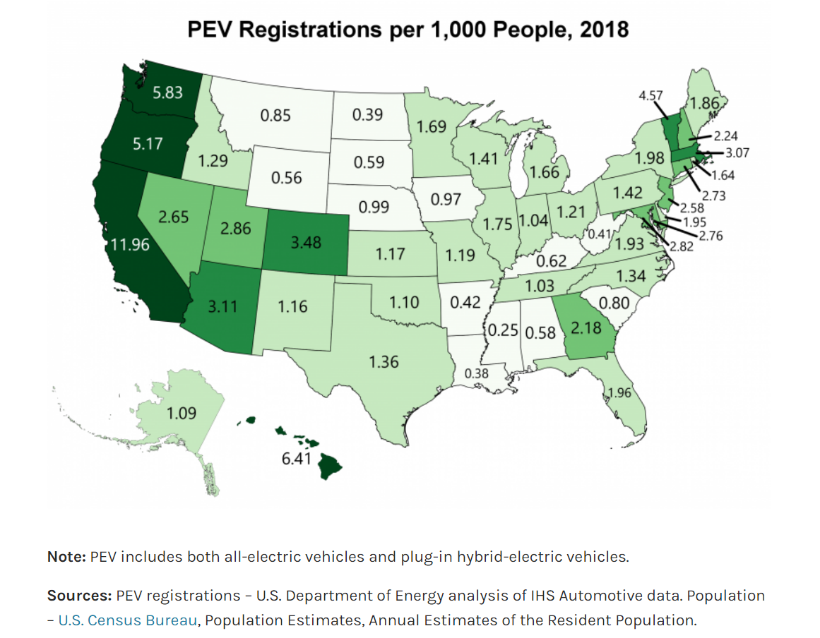
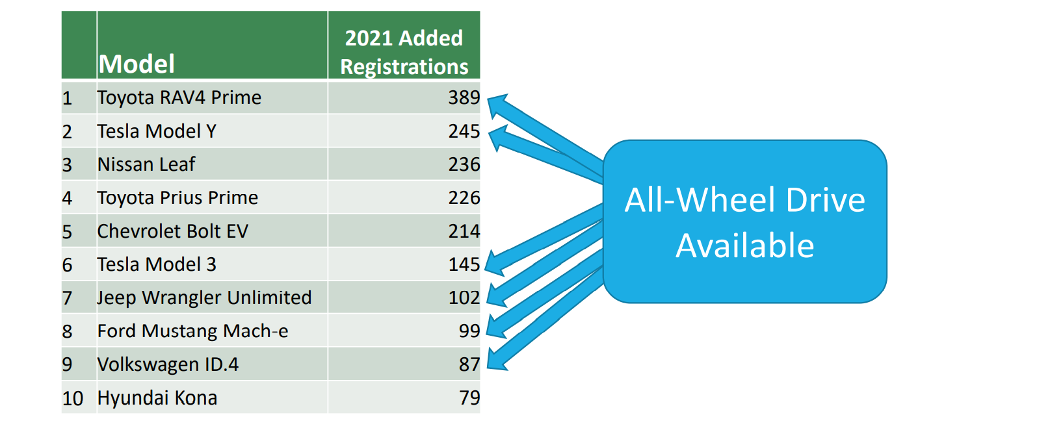
EV Adoption in Vermont
As of 2022, 10.23 registrations per 1,000 people,
more than double the 2018 figures
Ranked 5th in nation in 2021 US DOE analysis
Top EV models in 2021:

Slide 13
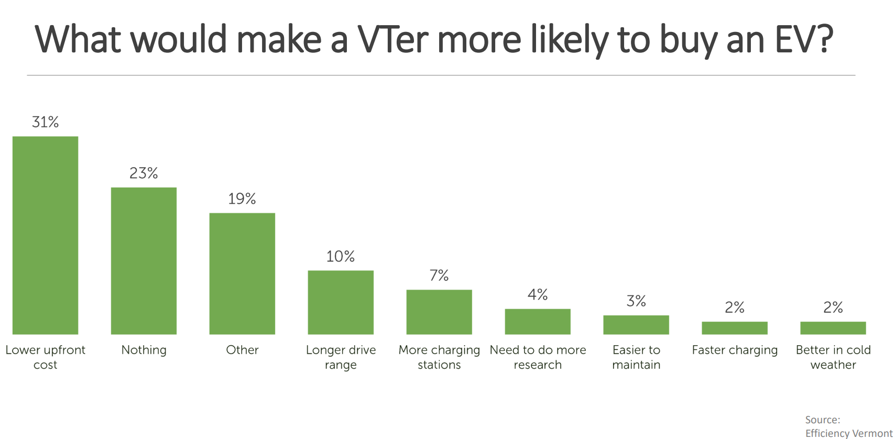
EV Adoption in Vermont
Webinar: Are Vermonters Ready To Drive Electric? | Efficiency Vermont

Slide 14
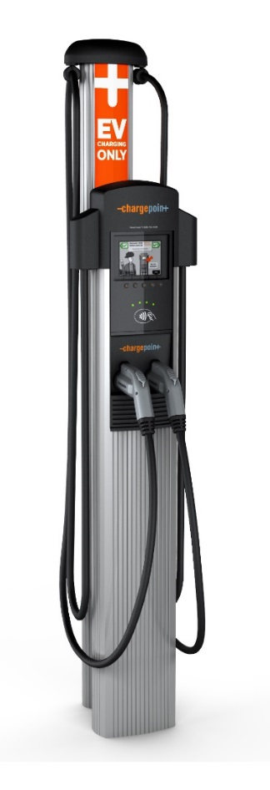
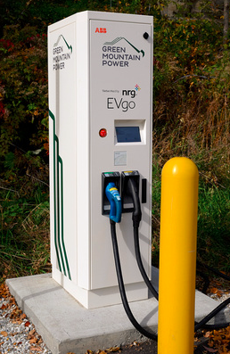
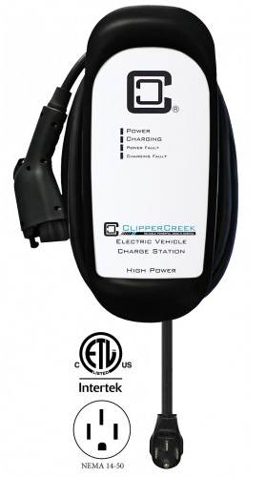
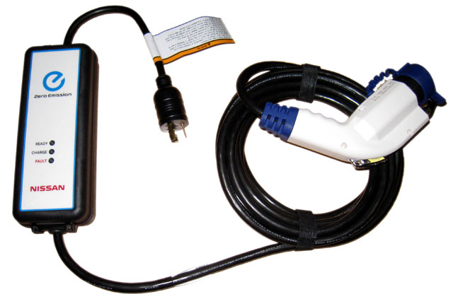




Charging Equipment
Level 1 Charging
120V
5 miles range / hr
Level 2 Charging
240V
10-20 miles / hr
DC Fast Charging
480V
Up to 1,000 miles / hr
Plug Types
J1772
Tesla
J1772
Tesla
CCS
CHAdeMO
Tesla

Slide 15
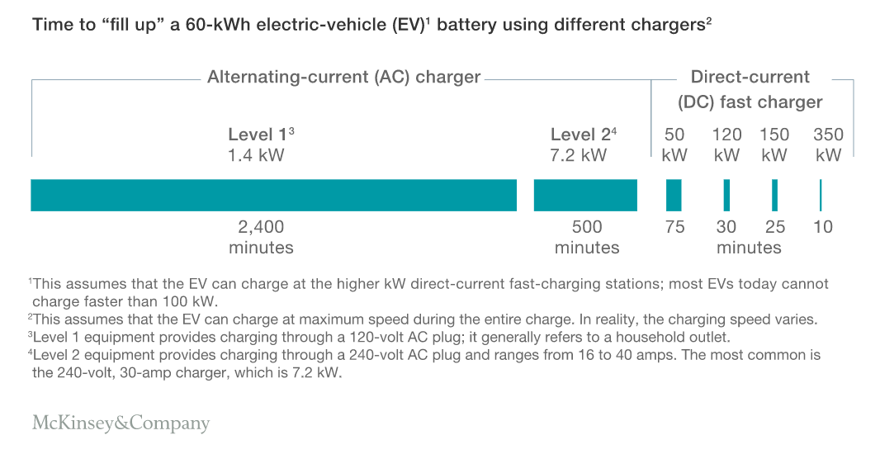
Charging Equipment
Mckinsey.com

Slide 16
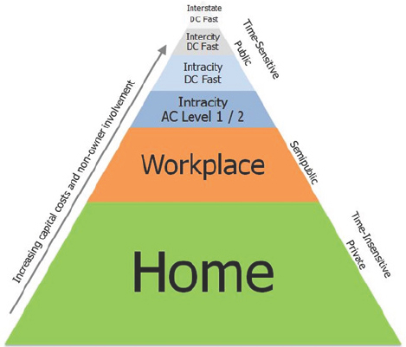
Charging Equipment
Differences between Community and Corridor Charging
Cost of infrastructure
Cost of charging
Charging speed
Trip purposes
Dwell times
Credit: National Academies Press

Slide 17
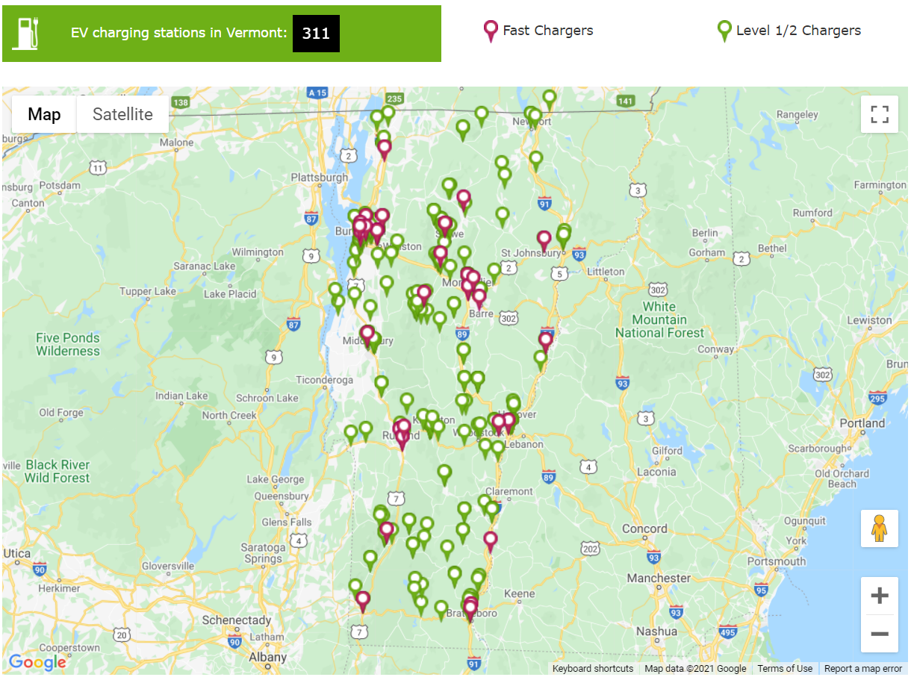
Vermont is #1
Public EV Charging Network in Vermont
State has higher number of public chargers per capita than any other state in the U.S.*
114 charging ports per 100,000 people
*Vermont — Highest Number Of Public Electric Vehicle Chargers Per Capita - CleanTechnica. U.S. Department of Energy, Alternative Fuels Data Center, Alternative Fueling Station Locator. Data accessed November 17, 2020.

Slide 18
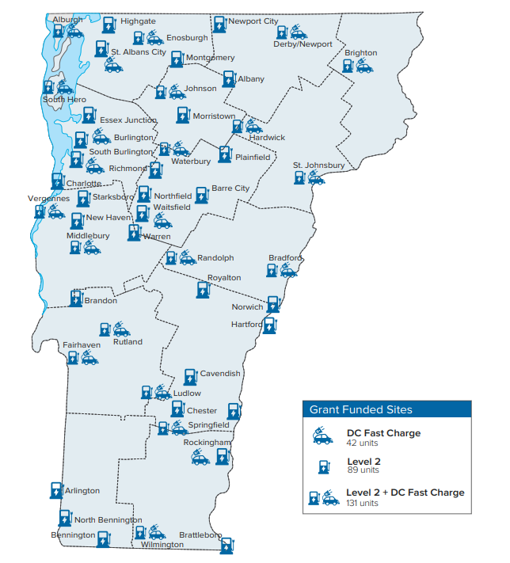
Funding Timeline
Public EVSE Investments in Vermont
2014: DHCD and Dept of Environmental Conservation launch Electric Vehicle Supply Equipment (EVSE) Program with $200k
2017: Volkswagen Settlement, $2.8 million
2019: ~ $1 million for 75 Level 2 + 5 DC Fast Chargers
2020: $1.7 million to Blink for 11 locations
2021: $750k in capital funds to Norwich Technologies for 6 locations
2022: $1 million to residential charging for multiunit housing
Department of Housing and Community Development: Interactive map

Slide 19
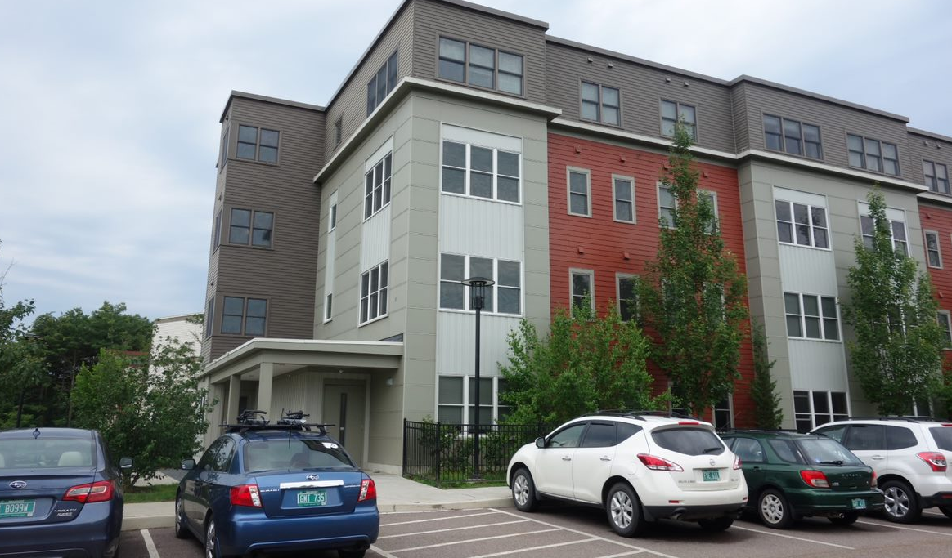
Awards Summary
EVSE for Multiunit Dwellings Program
Department of Housing and Community Development launched grant program in January 2022 for non-profit affordable housing developments of ten (10) units or more
13 awards in 37 locations
84 Level 2 charging ports
Projects to provide access to 6,230 affordable housing units in Bennington, Caledonia, Chittenden, Franklin, Grand Isle, Orleans, Washington and Windsor Counties

Slide 20
FY23 Budget
Continued State Investment in EVSE
State EVSE Goals
Updated to reflect more aggressive buildout, with a DCFC within 1 mile of every interstate exit, and within 25 miles of the next DCFC on the state highway network
EV Charging Infrastructure – Highway Network: $2 million
Supports the continued buildout of public charging infrastructure by providing $2,000,000 for highway networks to build upon the existing State and VW funding of public charging stations.
Additionally, AOT will receive $21,200,000 in Federal Highway funding (IIJA) over the next 5 years for highway network EVSE deployment.
EV Charging Infrastructure:
Supports the continued buildout of public charging infrastructure by providing $10,000,000 to ACCD for Level I & II charging for multi-family dwellings, workplaces, state parks and facilities and community attractions to build upon the existing State and VW funding of public charging stations.
$16.25 million:
$6.25 million for fast charging along highway corridors
$10 million for community charging
Notes:
Slide Example A

Slide 21
Timeline
NEVI Formula Program Guidance
Priority given to EVSE along the interstates for corridor nominations, and investments to be made there first. (When fully “built out” as certified by FHWA, State may move onto other locations)
New minimum requirements: 4 CCS ports of 150 kW each (600 kW total per site)
50 mile distance from the next charging location, but now only 1 mile from interstate exit or state highway intersection (prior radius was 5 miles)
Submission of state plans by August 1st, with required plan elements
No guidance yet on the following:
Minimum standards for equipment
Application of Buy America requirements
10% for Gap-filling grants
Competitive grant programs for Corridor and Community Charging
May 13th: Nominations were due for Alt. Fuel Corridors & guidance on minimum standards for EVSE (expected soon)
August 1st or before: States must submit EV Charging Plan to FHWA
September 30th: FHWA approval of plan
Fall 2022- Spring 2023: Public Engagement Plan
Updated Plan Due Annually
Notes:
Slide Example A

Slide 22
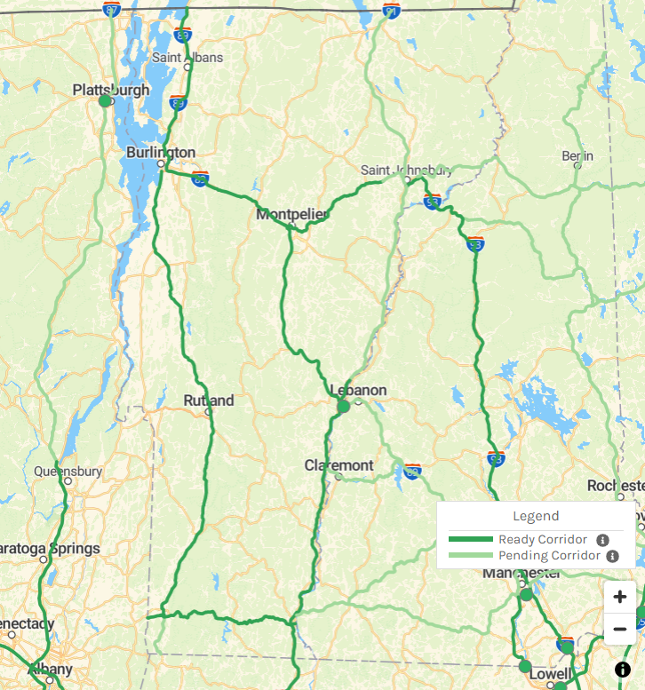
Alternative Fuel Corridors
FHWA Designation
Stations within 50 miles of the next on the highway system and within 1 mile of an exit, with few exceptions
Site power capability should be no less than 600 kW (supporting at least 150 kW per port simultaneously across 4 ports).
VT Corridor-Ready:
Interstates 89, 91; State Routes 9, 2, 7
VT Corridor-Pending:
US-2: Between Danville and VT/NH border
US-7: Between Bennington and VT/MA border
Notes:
Slide Example A

Slide 23
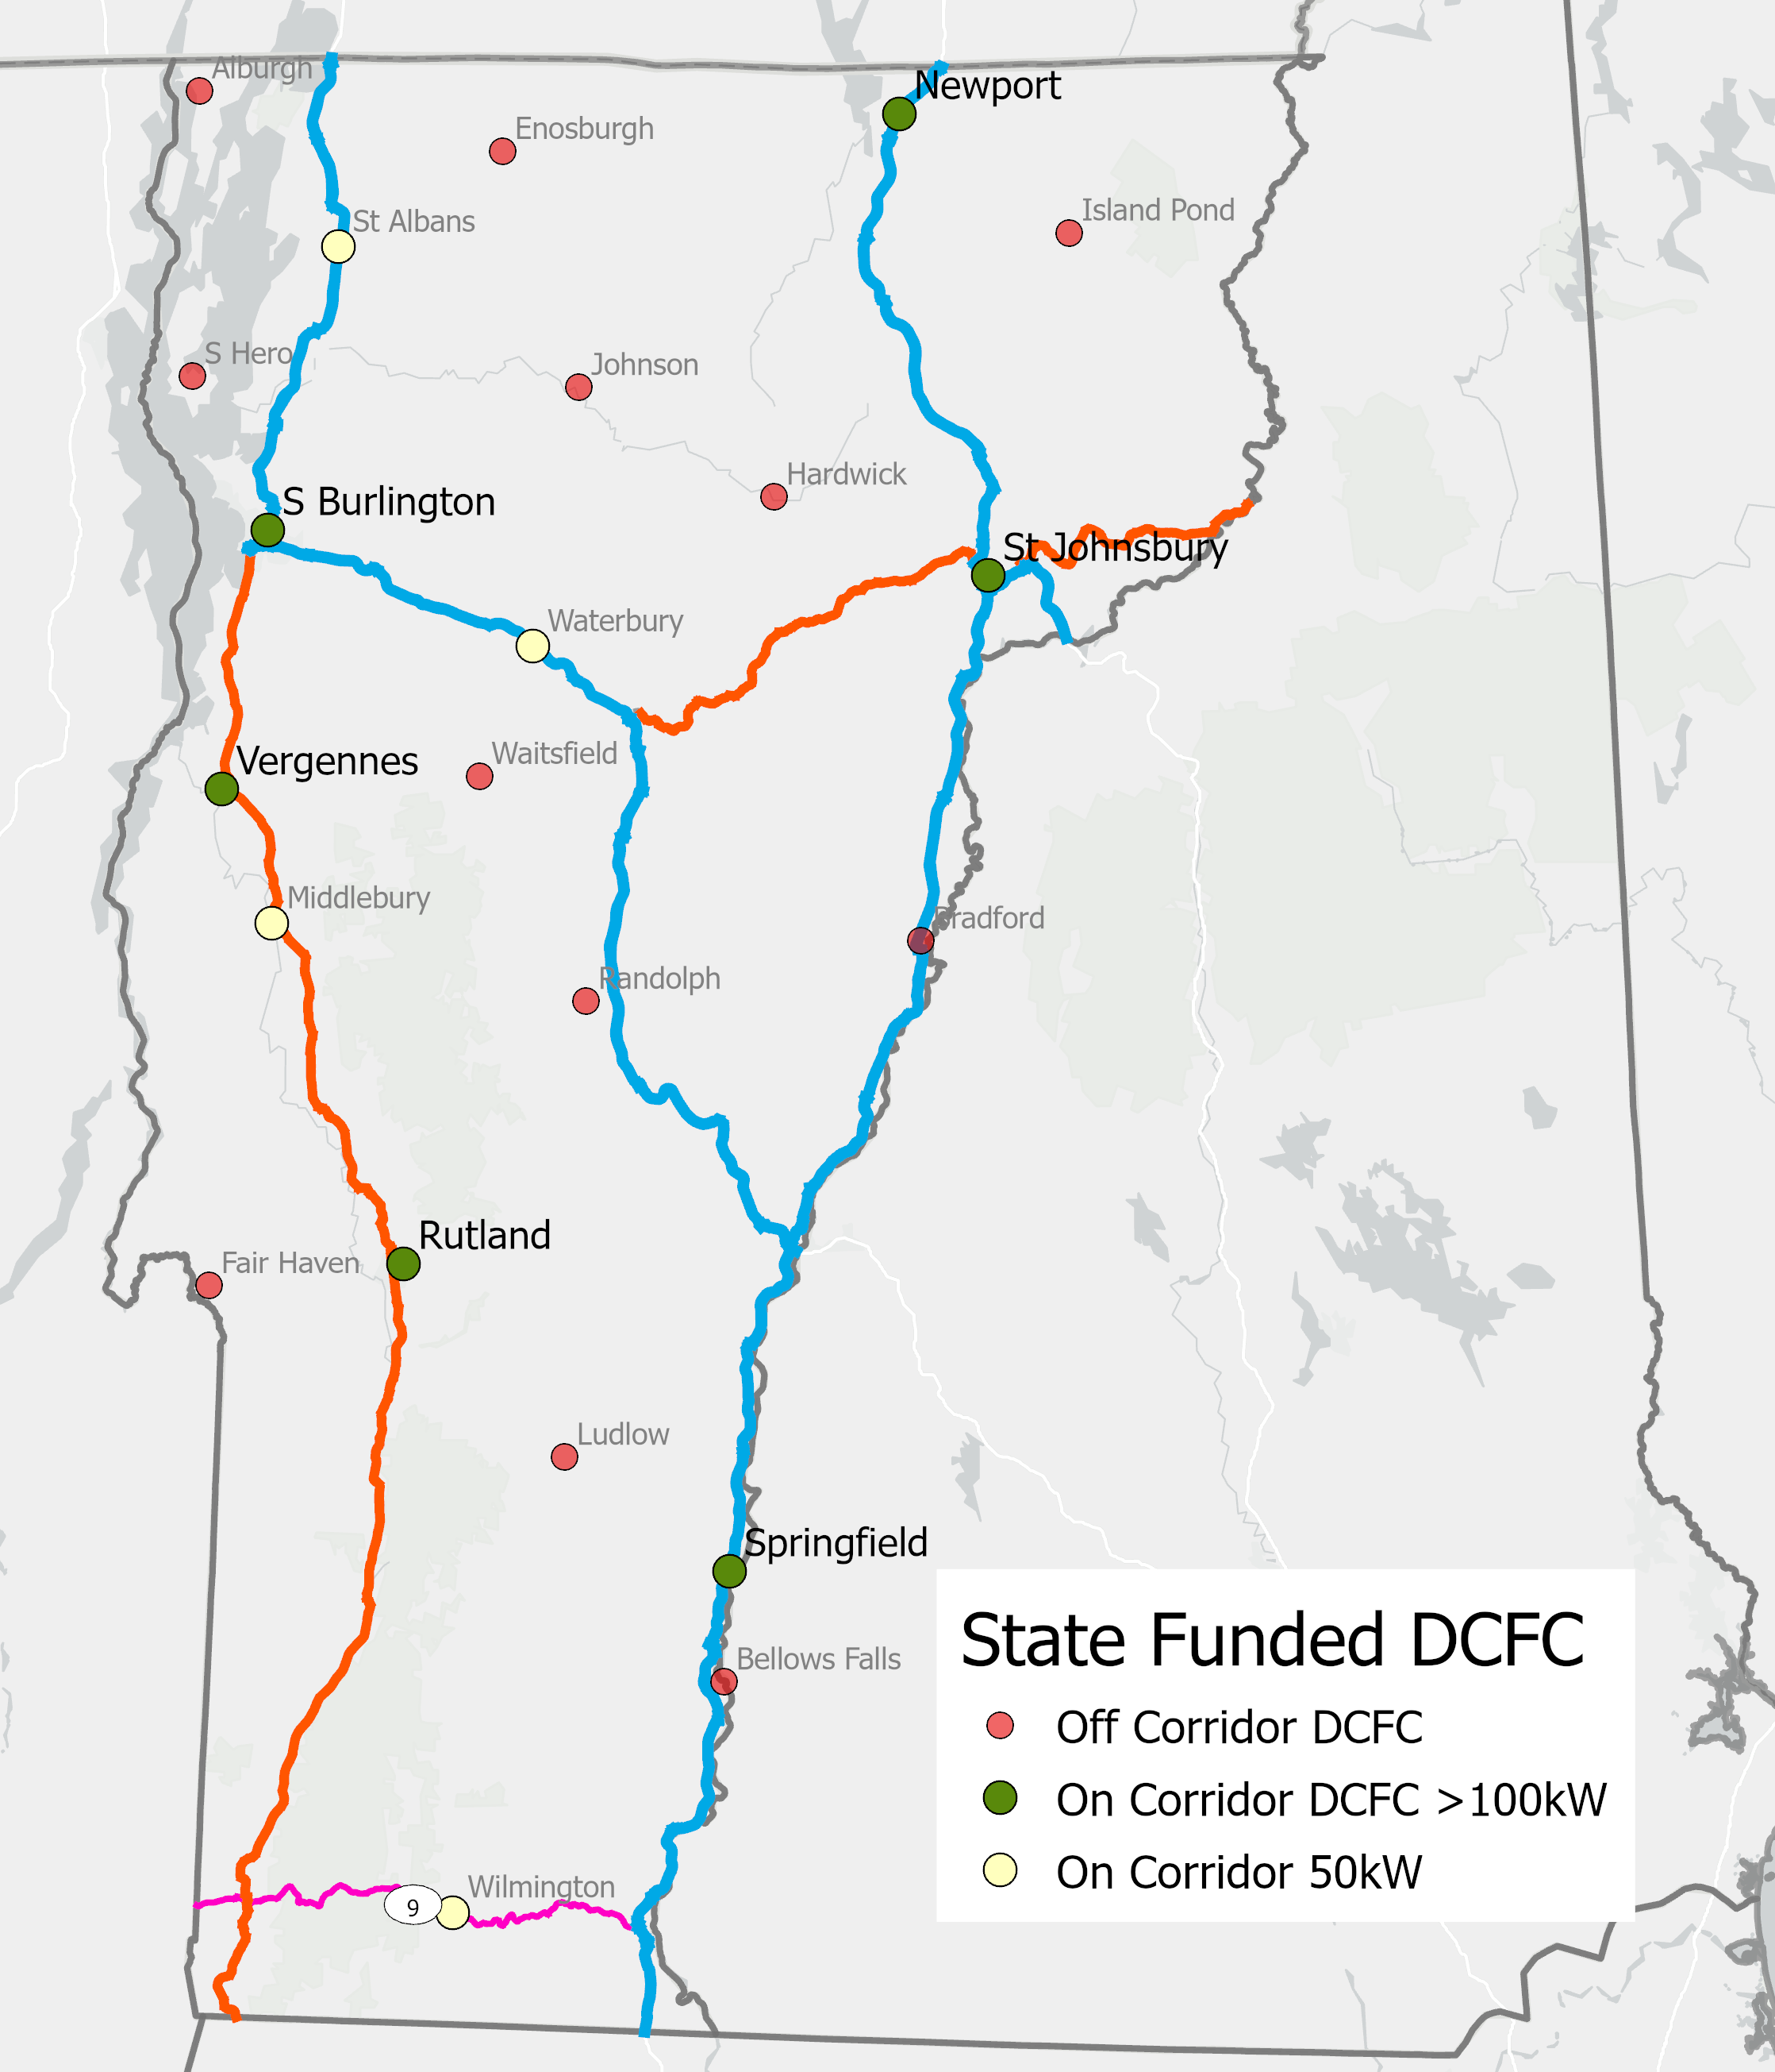
EVSE Network Coverage
FHWA Designation
No corridor segments appear ready to convert given current guidance
Most, if not all, existing locations would be required to upgrade the number of ports and/or the capacity of the chargers
Move from 5 to 1 mile distance from exits/intersections may result in multiple requests for exceptions, for lack of electrical service or local businesses
Notes:
Slide Example A

Slide 24
EVSE Network Coverage
FHWA Designation
No corridor segments appear ready to convert given current guidance
Most, if not all, existing locations would be required to upgrade the number of ports and/or the capacity of the chargers
Move from 5 to 1 mile distance from exits/intersections may result in multiple requests for exceptions, for lack of electrical service or local businesses
Meeting Federal guidance would require adding or upgrading about 15 fast charging locations
Notes:
Slide Example A

Slide 25
National Electric Vehicle Infrastructure Funding (IIJA)
Cost per Location for four 150kW DC Fast Chargers
DCFC Equipment | $300,000
Design & Permitting | $30,000
Labor & Materials | $190,000
Warranty / Maintenance | $80,000
Minimum total per location | $600,000
  Apportionment for VT
  Federal FY2022: $3,140,247
  Years 2-5: ~$4.5 million/yr
  Total: $21+ million
  10% of annual funding to be set aside for “gap-filling” grants to rural areas
  Competitive grant funds for Corridor & Community Charging
Total for 15 corridor locations is a minimum of
$9 million
05/18/2022
Notes:
Costs adapted from ICCT 2019 report and industry sources
https://theicct.org/sites/default/files/publications/ICCT_EV_Charging_Cost_20190813.pdf

Slide 26
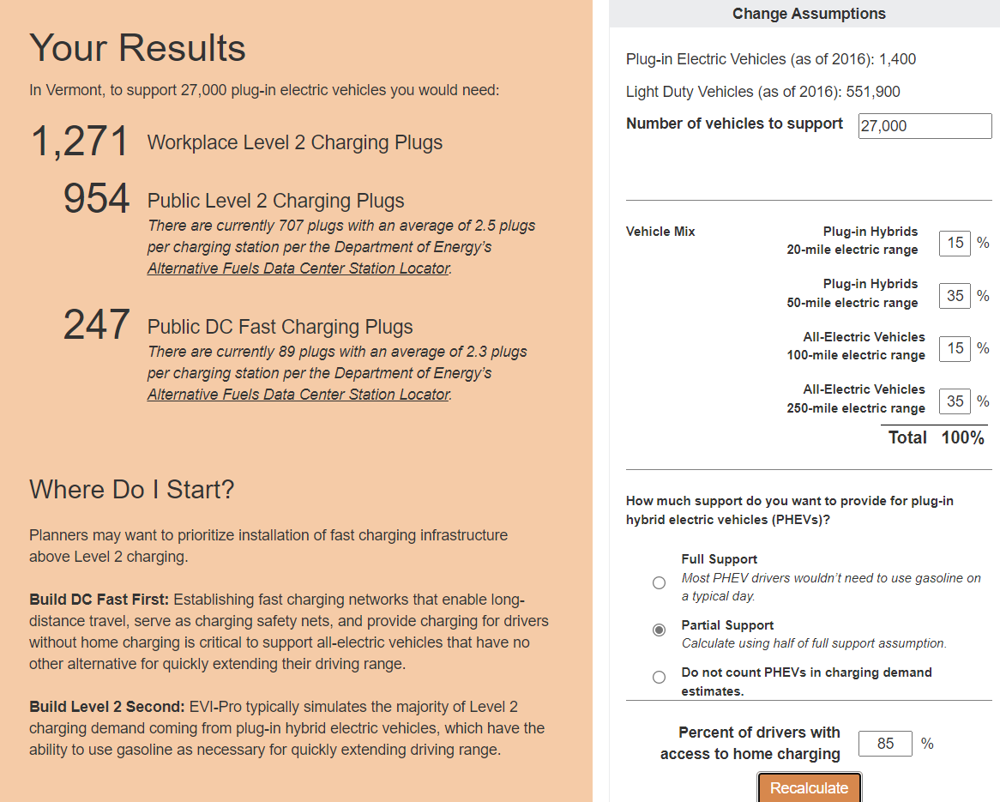
Projected Charging Needs for 2025
To support 6,585 PEVs in VT:
330 Workplace Level 2 Plugs
262 Public Level 2 Plugs
69 Public DC Fast Charging Plugs
Vermont currently has:
714 Public Level 2 Plugs
76 Public DC Fast Charging Plugs, with more in progress
To support 27,000 PEVs in VT by 2025:
At least another 250 Level 2 plugs
At least another 150 DCFC plugs in 38+ locations
Credit: Alternative Fuels Data Center, EVI Pro-lite
05/18/2022
Notes:
Slide Example A

Slide 27
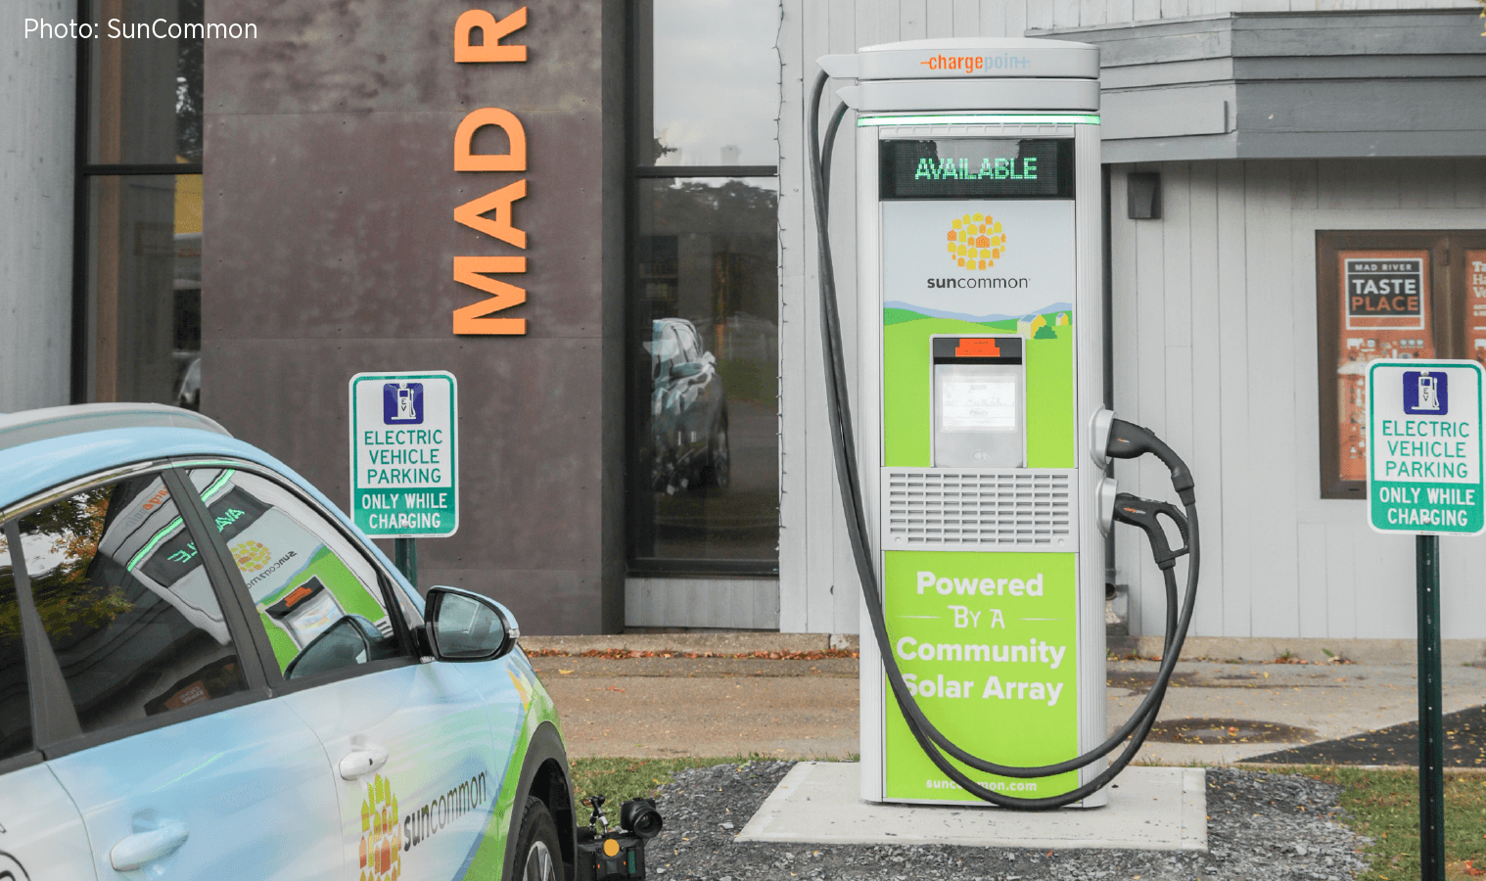
Statewide EV Charging Plan
Different use cases and interconnections: residential, workplace, highways
Trends, projections, goals for EV adoption in Vermont, current and future requirements
Funding sources and EVSE policy—federal, state, local, utility
Strategies from other states and places to increase charging availability
Financial modeling for EV charging deployment—how many, over what time period, for what cost? How can public investments encourage private investment in EVSE network, and by when?
Fleet (including medium and heavy-duty) considerations
Infrastructure Resiliency and Emergency Response
EVSE siting prioritization and mapping analyses of gaps/need for redundancy
Notes:
Slide Example B

Slide 28
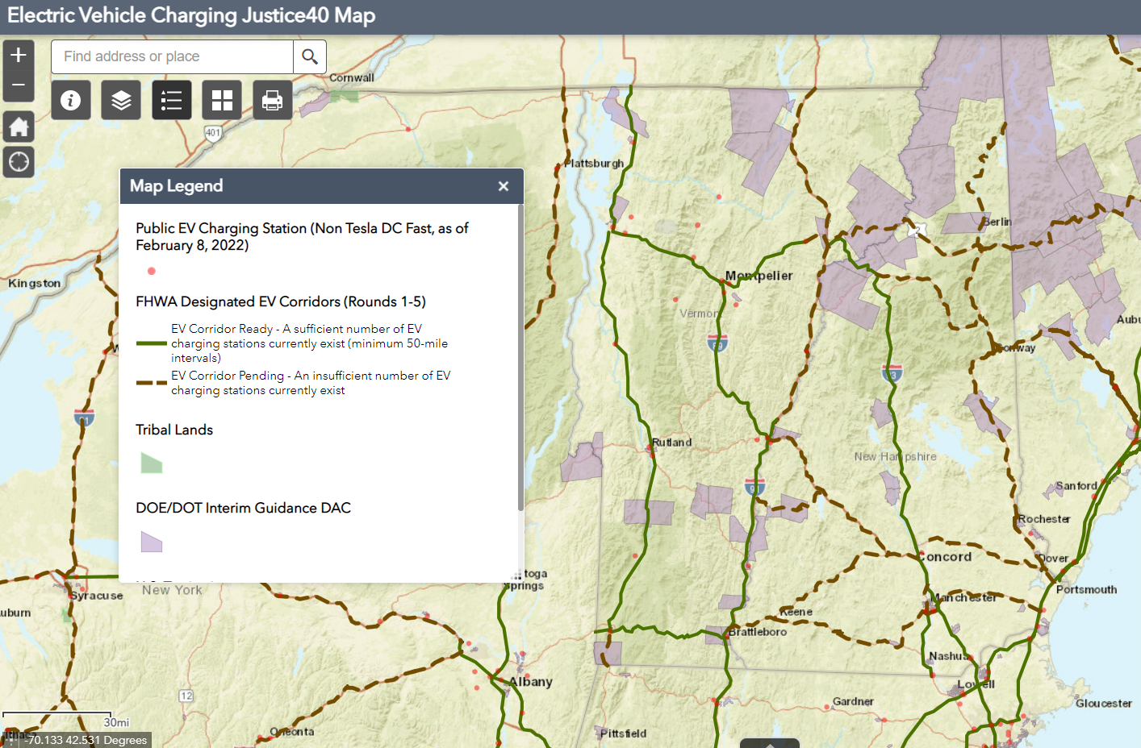
Public Engagement
FHWA Required State Plan Elements
States should consult with entities including:
Metropolitan Planning Organizations and Regional Transportation Planning Organizations; Counties and cities, including coordination with existing EV charging programs; State departments of energy, including Clean Cities Coalitions; State environmental protection agencies; State economic development agencies; State public utility commissions; State weights and measurement agencies; State and Federal land management agencies; State manufacturing extension partnerships; State department of motor vehicles; State department of commercial motor vehicles; Responsible emergency/disaster preparedness functions in the State; Tribal governments; Electric utilities and transmission and distribution owners and regulators; Electric vehicle service providers; Public transportation agencies; Port and freight authorities; Community-based organizations, environmental justice and environmental protection organizations, small business associations, Chambers of Commerce; labor organizations, and private entities; and Other appropriate parties…And Private sector EV charging infrastructure owners and network operators; Vehicle manufacturers; Unions and other labor organizations; Real estate industry groups; Minority- and women-based organizations; Freight industry groups; EV industry organizations and EV advocacy groups, as applicable; Gas station owners and operators; Taxicab commissions and ridesharing companies; Emergency management and public safety agencies; and Other appropriate parties
    State Agency coordination
    Public engagement
    Plan vision and goals
    Contracting
    Existing and future conditions
    Implementation
    Civil Rights
    Equity Considerations
    Labor & workforce considerations
    Cybersecurity
    Program Evaluation
Notes:
Slide Example A

Slide 29
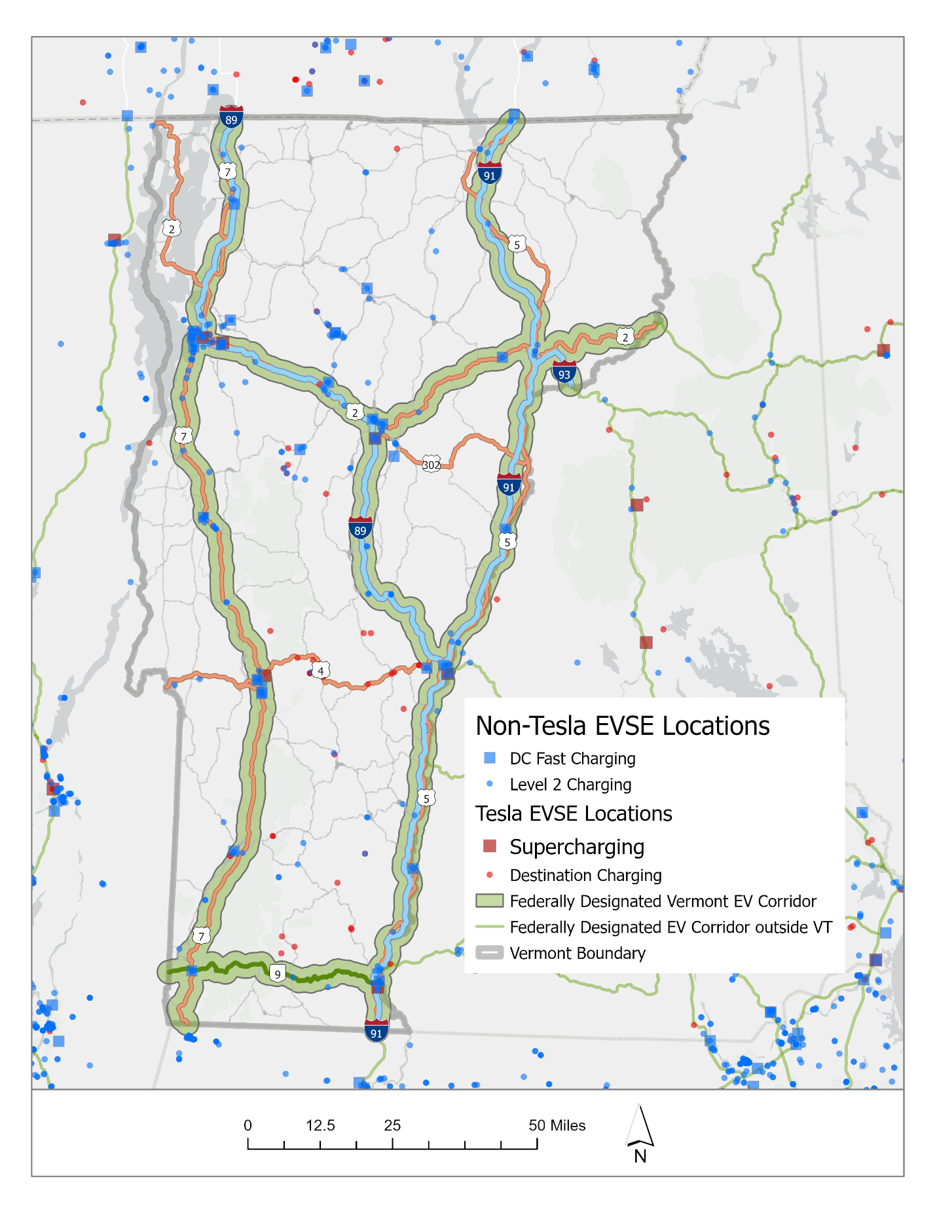
General Location Prioritization Factors
Highway traffic volumes
Travel services and other employment
Walkability
Environmental justice factors related to income and race
Multifamily housing units
3-Phase power availability
Proximity to federally designated EV corridor
Distance to qualifying EV charging location with four 150kW DCFC ports
Notes:
Plan may not set specific locations, but intended to help guide investments

Slide 30
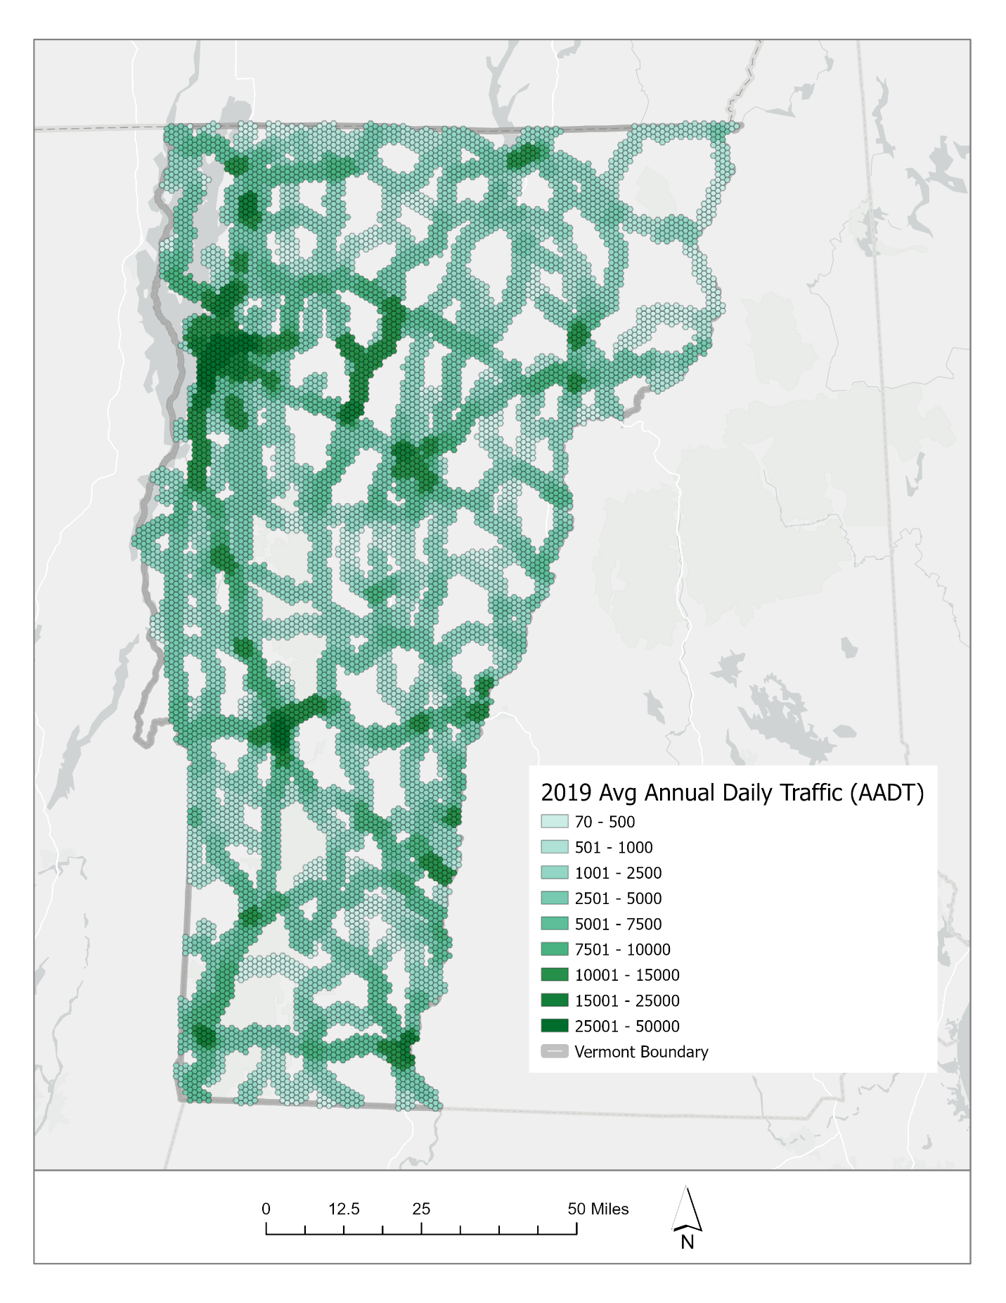
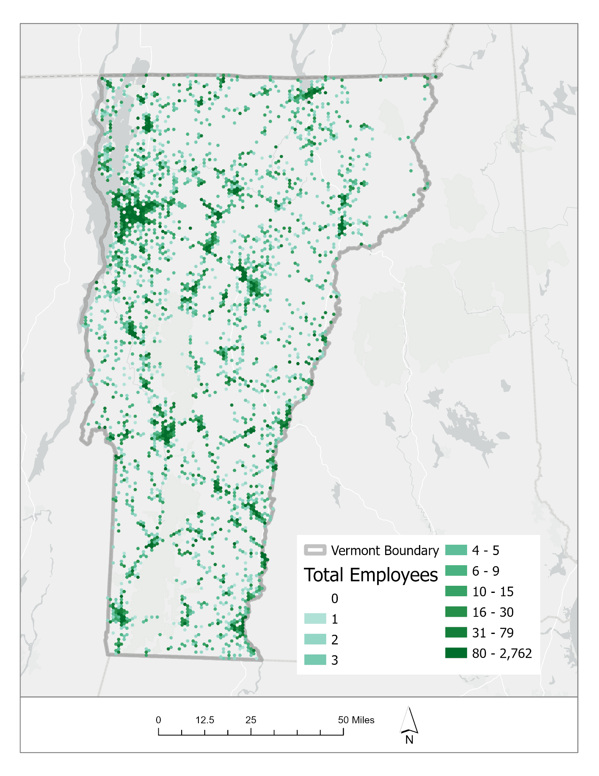
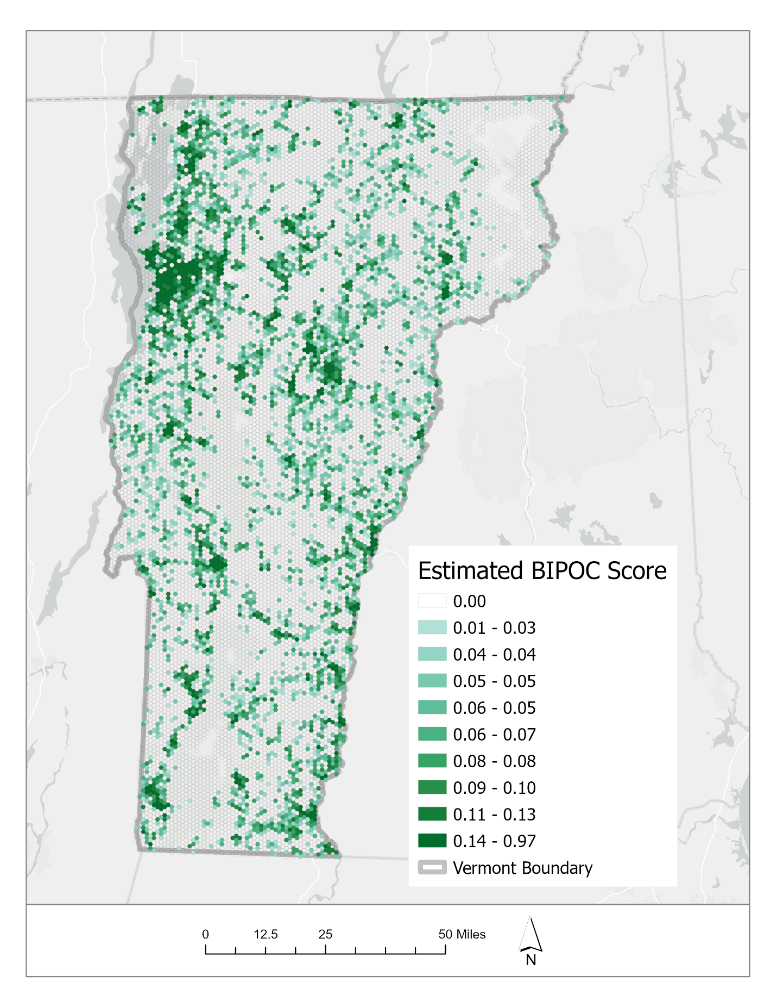
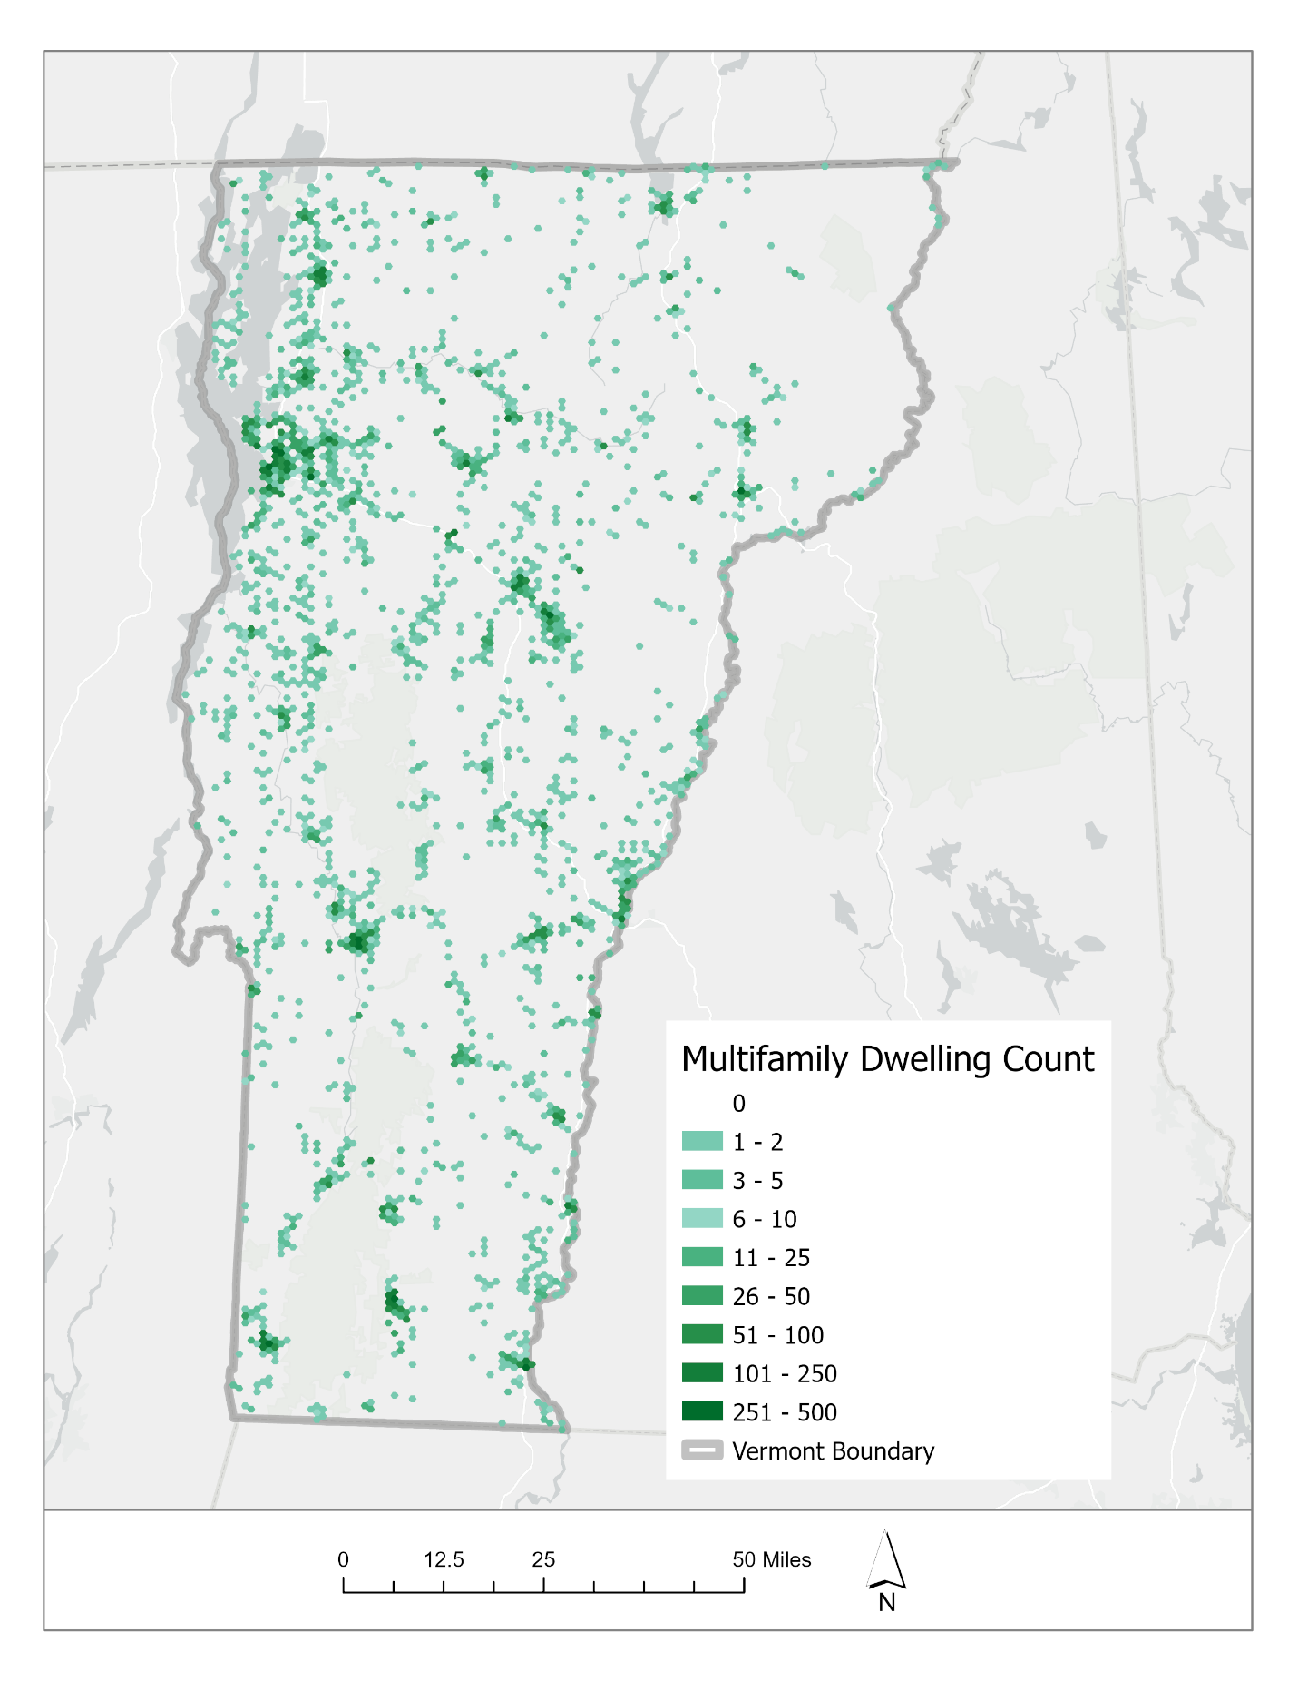
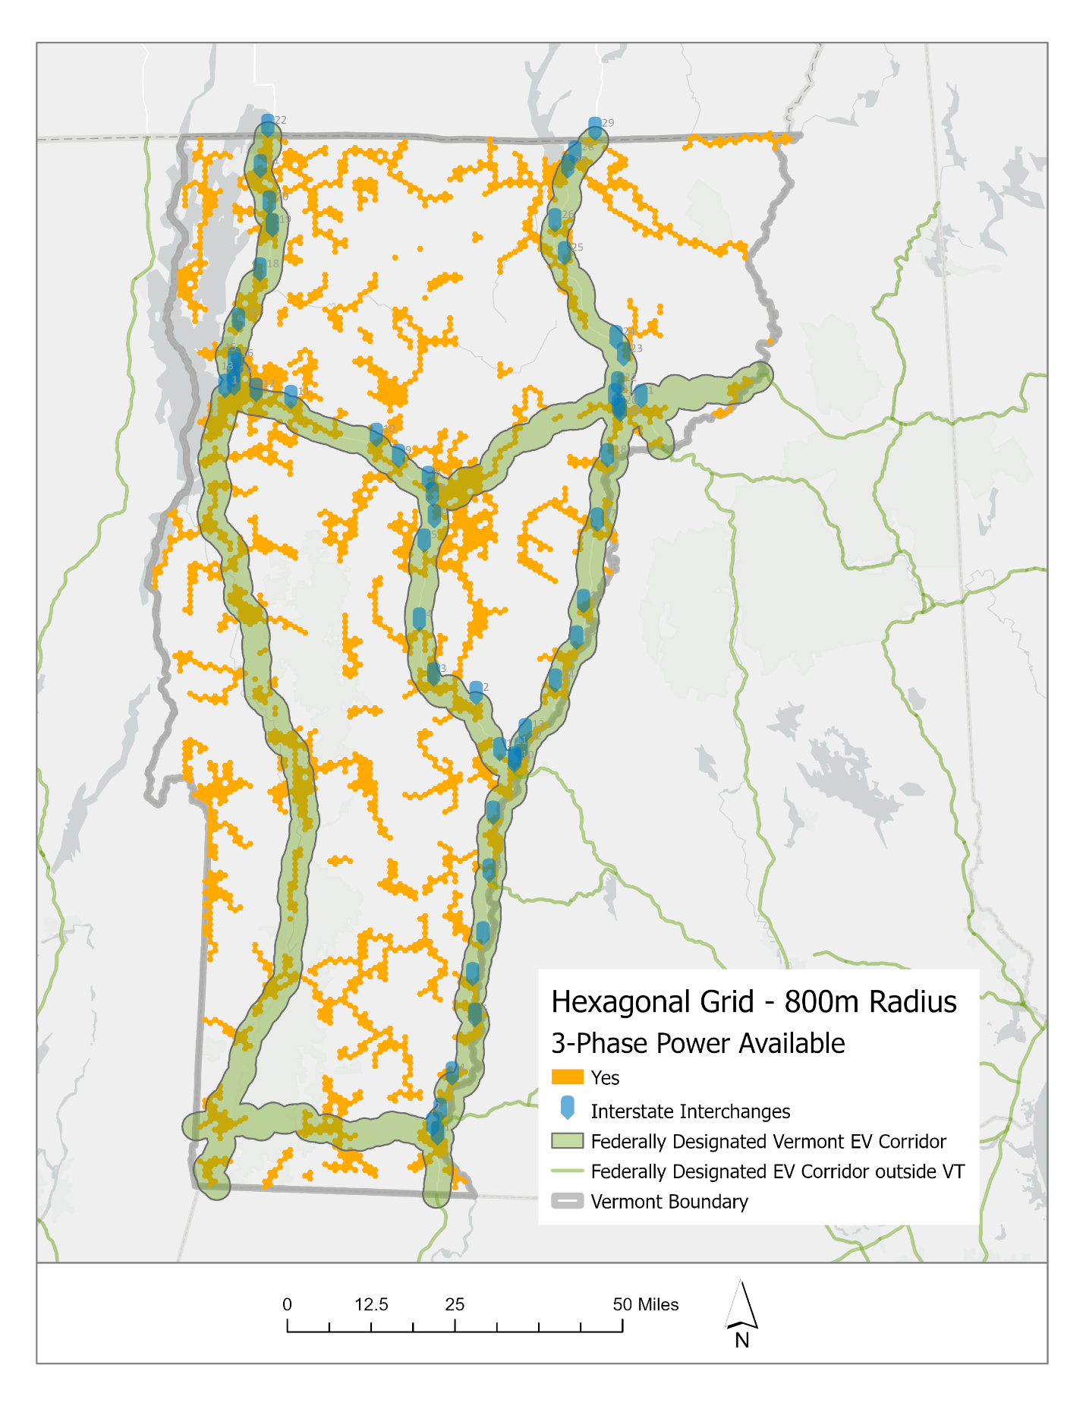
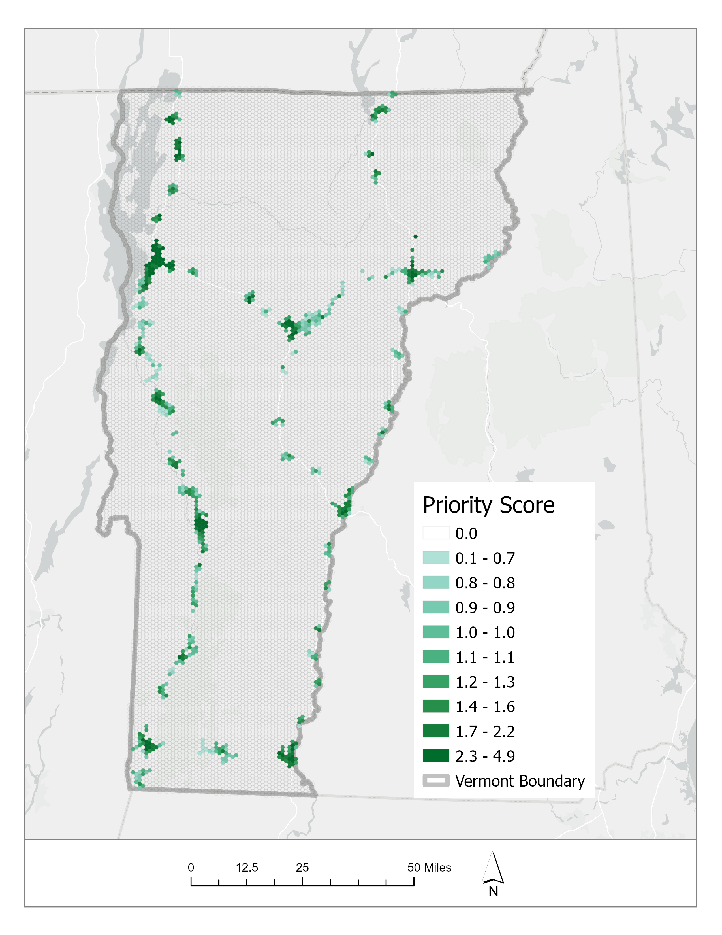
DRAFT Prioritization Mapping
Factors are mapped into hexagonal grid cells that are about ½ mile radius
Quantities are normalized to allow combinations across different types of priorities
Final priority score for initial NEVI plan is limited to eligible areas along federally designated EV corridors
Future plans will likely expand on this as additional federal and State guidance develops

Slide 31

Breakout Discussions
What do you think of the State’s goals for public fast charging availability
  Within 1 mile of every interstate exit; within 25 miles along State highways
How can the State work with partners to leverage the federal and state funds?
How can the State support EV drivers who may not have access to charging at home?
What can be done to increase the reliability of public EV charging?
Notes:
Slide Example B

Slide 32
Next Steps
By June 2022: Incorporate public input, stakeholder and agency feedback into a draft NEVI plan for Vermont
Post a draft plan on VTrans website and share for further feedback and refinement
June 6th: Review draft with Joint Office (US DOT/DOE)
Summer 2022: Issue RFPs
Fall 2022 – Spring 2023: Public Engagement Plan for future rounds
Spring 2023: Preparation of annual plan update; breaking ground on first round of projects?
Notes:
Slide Example B

Slide 33
Contact
Patrick Murphy​
Sustainability & Innovations Project Manager
Policy, Planning & Intermodal Development Division​
Vermont Agency of Transportation​
​
802.595.6738​
Patrick.Murphy@vermont.gov
Notes:
Slide Example B

Slide 34
Thank you!
Patrick Murphy​
Sustainability & Innovations Project Manager
Policy, Planning & Intermodal Development Division​
Vermont Agency of Transportation​
​
Patrick.Murphy@vermont.gov
Peggy O’Neill-Vivanco
VT Clean Cities Coordinator
UVM Transportation Research Center
poneillv@uvm.edu
Dave Roberts
Drive Electric Vermont Coordinator
droberts@veic.org
Jessica Poulin
VT Clean Cities Program Assistant
jjpoulin@uvm.edu

