Slide 1
Climate Change: How New Federal Legislation Impacts Vermont
Vermont Agency of Transportation - 2022 Research and Innovation Symposium
September 14, 2022
By James Bradbury, Mitigation Program Director

Slide 2
Overview
Climate change is happening now, getting worse
States like VT are key climate leaders
Bipartisan Infrastructure Law presents significant investment opportunities
State policies and investment decisions will be critical to bend the curve down on emissions
The Investment Reduction Act complements to BIL

Slide 3
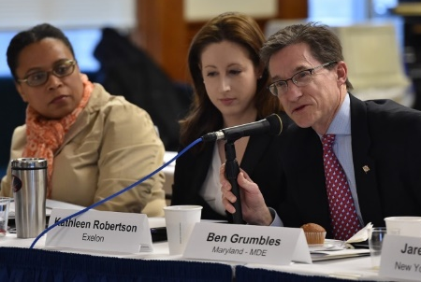
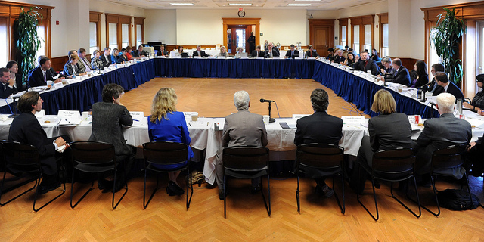
Georgetown Climate Center: A Resource for State and Federal Climate Policy
Launched in 2009 as a resource to states
Works at the nexus of federal-state policies
Supports states through research, facilitation, and convening

Slide 4
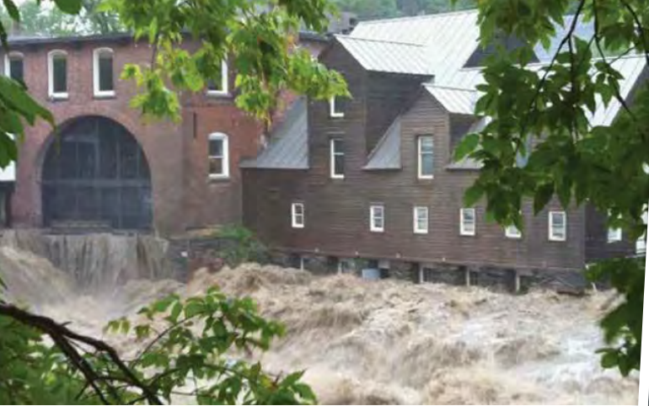
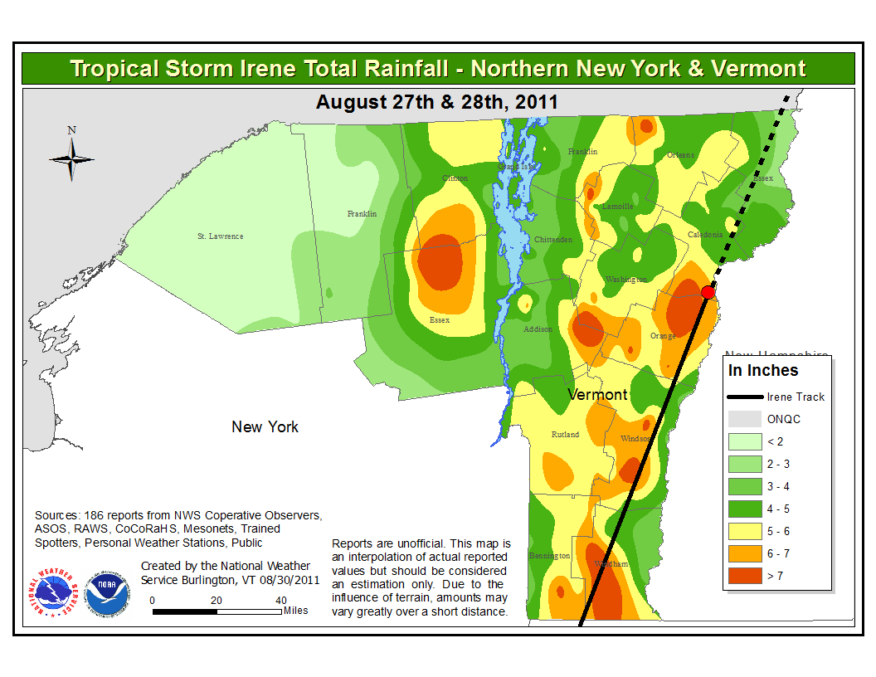
Climate Impacts are Here & Getting Worse
A warmer climate brings many hazards
Hurricane Irene caused major damage in VT: images →
Future impacts will be greater
(Source: Irene Recovery Status Report, 2013)
(Source: NWS/ NOAA)

Slide 5
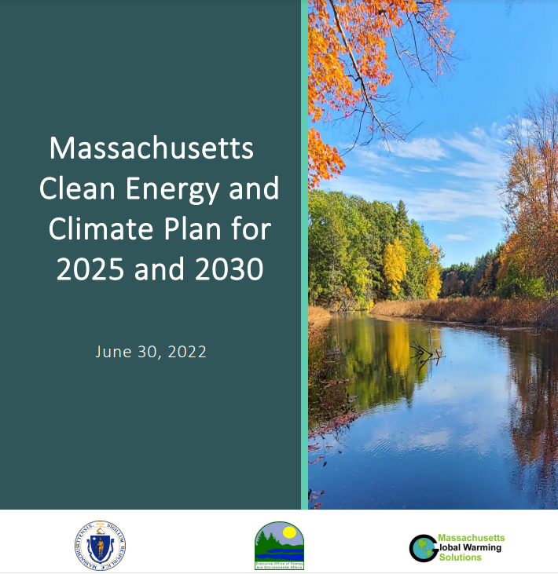
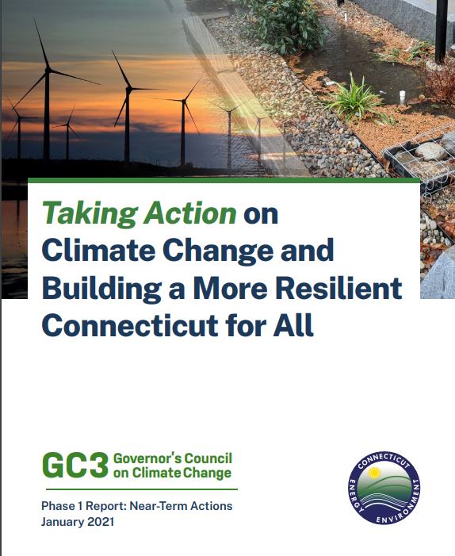
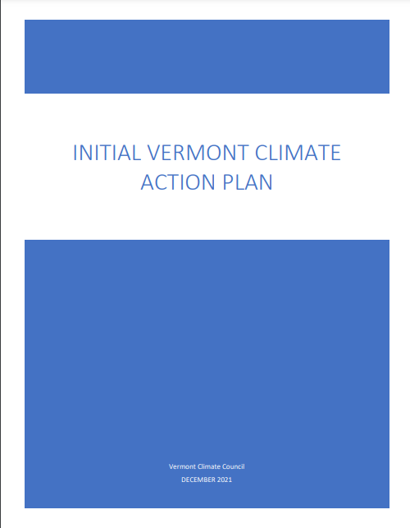
Northeast States are Climate Leaders
NASTO region energy-related CO₂ emissions, 2019
(EIA, 2022)
Transportation is the largest GHG emission source
Many states have ambitious and legally binding emission reduction targets
Action plans include ambitious EV deployment goals.
Some include VMT targets
A range of strategies are needed

Slide 6
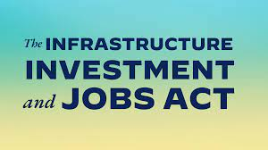
Bipartisan Infrastructure Law Presents Opportunities for Low-Carbon Transportation Investments
Formula funding:
NHPP, STBG, CMAQ, etc.
National Electric Vehicle Infrastructure
Carbon Reduction Program
Transportation Alternatives set-aside
Competitive grants:
Charging and Fueling Infrastructure
Low or No Emission transit buses
Reconnecting Communities Pilot
Etc.

Slide 7
BIL: Potential to bend the curve down, but investment decisions matter
Potential for emission reductions, including with existing strategies
Implementation decisions will have significant impacts
- 3 MMT; -0.2%,
-21 MMT; -1.6%
+21 MMT; +1.6%
-14 MMT; -1.3%
7
Source: https://www.georgetownclimate.org/articles/federal-infrastructure-investment-analysis.html

Slide 8
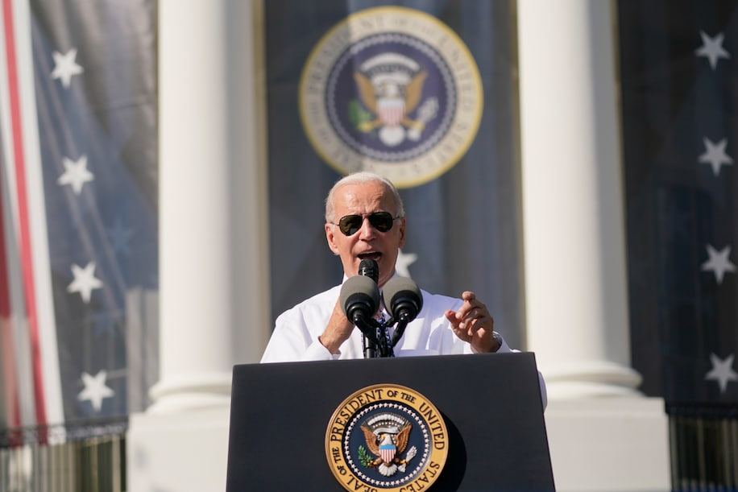
Inflation Reduction Act Complements the BIL
Primary focus on electric power sector/
beneficial electrification
Several new multi-sector programs
e.g., Greenhouse Gas Reduction Fund
Transportation
Aims to build a domestic EV market & supply chain
Includes new low-carbon transportation materials program

Slide 9
Many Opportunities for State DOTs to help Cut Emissions
New federal policy context
Laws: Use flexibility to expand investments in low-carbon infrastructure
Regulations: sets declining targets for transportation emissions
State policy opportunities
Advance new policies to leverage federal dollars
Align transportation planning with climate action planning
Pursue inter- and intra-agency collaborations

Slide 10
Thank you!
For more information, please visit: georgetownclimate.org
Connect with us on social media:
@Climate_Center
@GeorgetownClimate
Contact:
james.bradbury@georgetown.edu

Slide 11
Appendix

Slide 12
Resources
https://crp.trb.org/nchrpwebresource1/

Slide 13
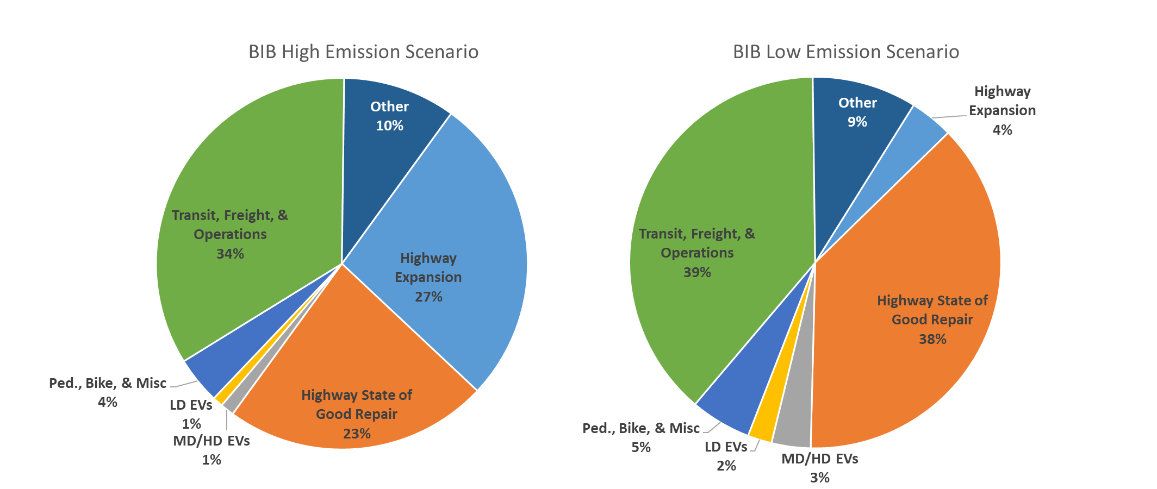
BIL Analysis Inputs: Two investment scenarios for $599 billion
BIL High-Emission Scenario
BIL Low-Emission Scenario

Slide 14
BIL long-term: Percentage of funding invested in highway expansion vs. other strategies is main driver of emissions outcomes
Note: Charts show cumulative MMT of CO₂ emissions, relative to the GHG baseline, 2022 to 2040.

