Slide 1
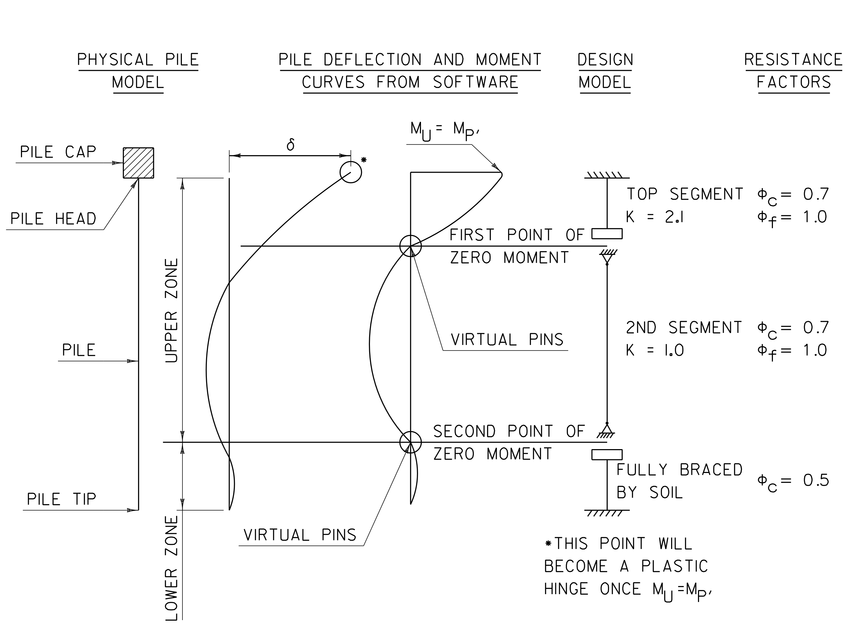
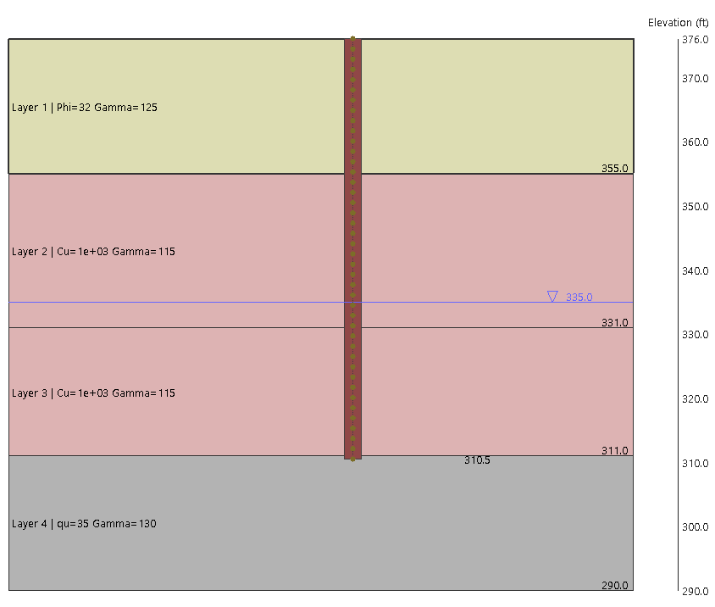
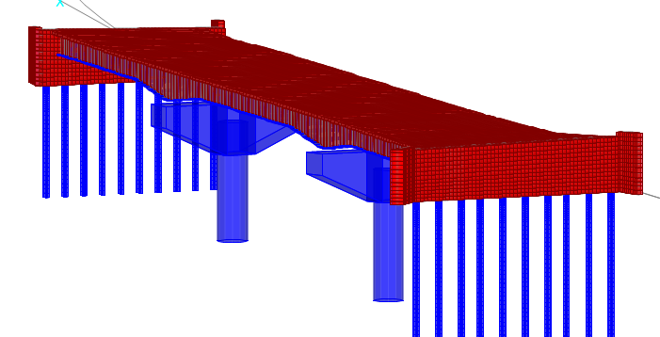
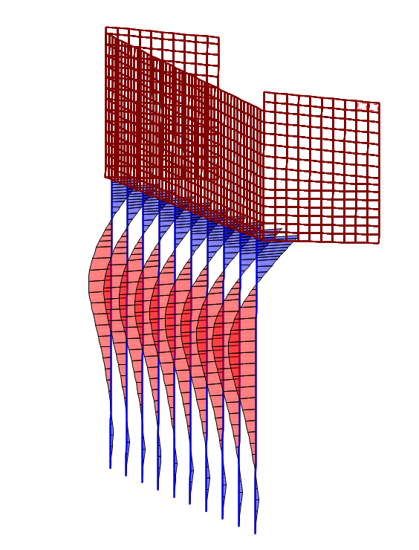
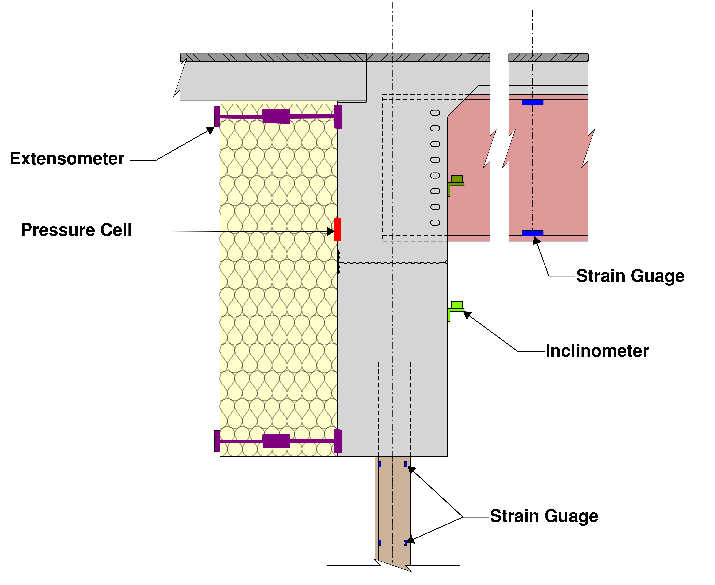
PUSHING THE LIMITS OF INTEGRAL ABUTMENTS
Bridge No. 7, Hartford, VT
Integral abutments bridges (IAB’s) are cost effective, rapidly constructed supports with reduced long-term maintenance. Lack of standardized design practices has restricted the use of IAB’s to more conventional structures. VTrans is making steps to expand the use of IAB’s to longer, more complex sites.
Simplified analyses
Generally Appropriate for Low Skew, Symmetric Bridges Less than 400-ft
Single Pile Analysis with Soil Interaction, Weak Axis Only
Postprocess as Simplified Series of Beam-Columns
Ideal Site Conditions
Hartford Bridge 7 Challenges
Excessive Thermal Expansion
Variable Subsurface Conditions
Asymmetric Abutments
Flared and Curved Roadway
Skewed Substructures
Relatively Steep Profile
Simplified Analysis
Refined analyses
Global Model Using CSi
Nonlinear Springs for Soil and Geoinclusion
Enveloped Solutions
Construction Phasing
Live Load Paths, Thermal Expansion and Contraction
Structural monitoring
Approximately 300 Sensors
Monitoring to Commence During Construction (2-year Construction)
5-Year Monitoring Plan
Discrete Live Load Testing Planned
Partnering with VTrans and UMass Lowell
Desired Outcomes
Understand Accuracy of Modeling
Confirm Anticipated Movements and Behavior
Use Information for Future Designs
© 2023 HNTB Companies

