Slide 1
Vermont Multimodal & Highway Guidelines
Stakeholder Advisory Group (SAG) & Technical Working Group (TWG) Meeting #1
June 5, 2024
Notes:
Kara & Wayne

Slide 2
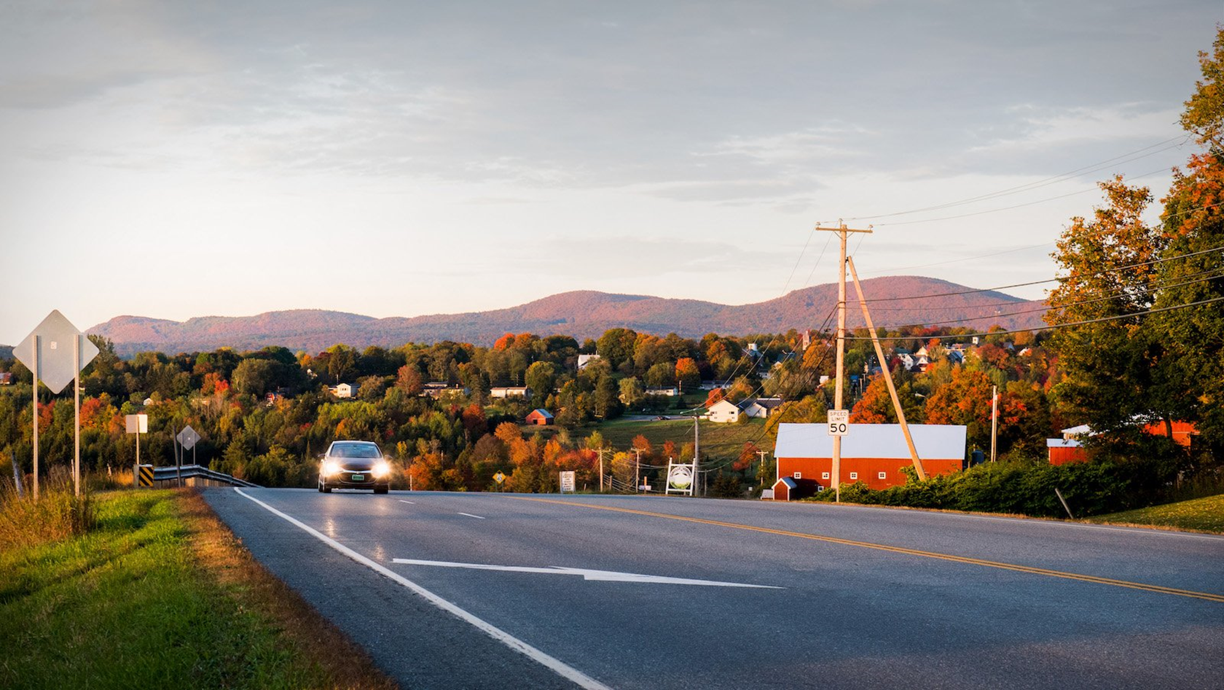
Welcome!
Notes:
Kara

Slide 3
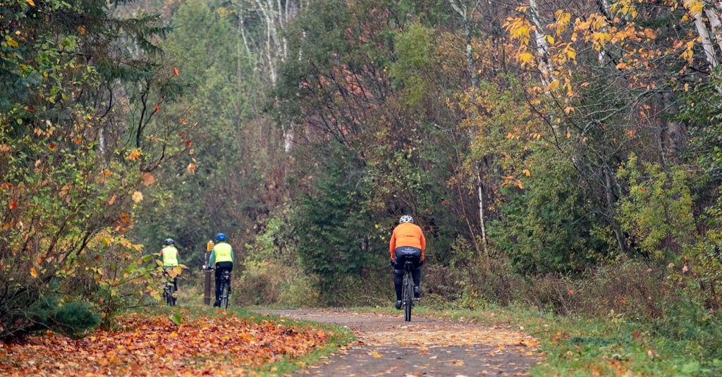
Zoom / IT Logistics
1
INTRODUCTION
Notes:
Matt

Slide 4
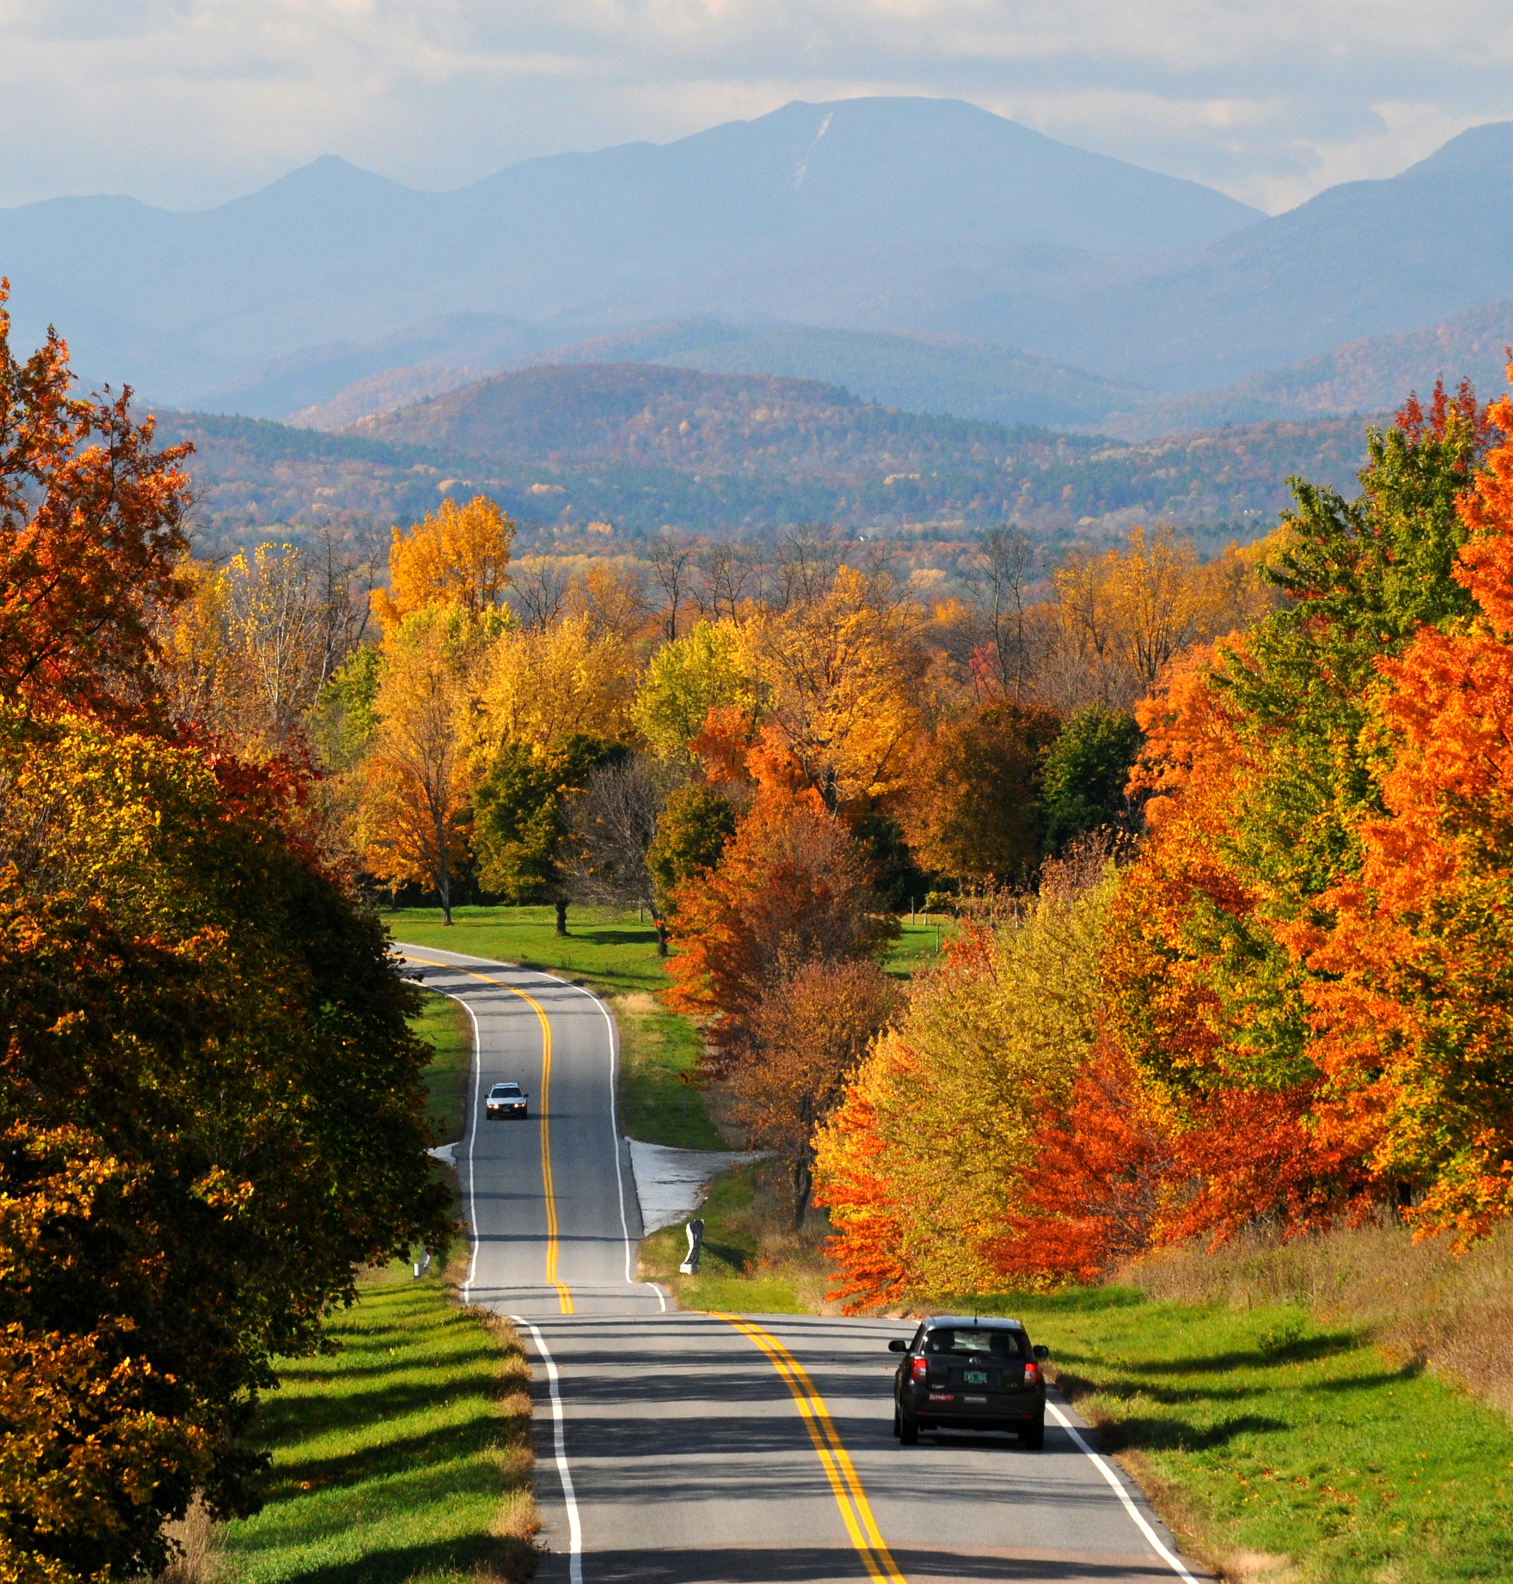
Agenda
INTRODUCTION
PROJECT OVERVIEW
PROJECT OUTCOMES
BREAKOUT GROUP DISCUSSIONS
GLOBAL REPORT BACK
NEXT STEPS
1
2
3
4
5
6
Notes:
Wayne

Slide 5
Project Team
1
INTRODUCTION
VTrans
Consultant Team: VHB and Toole Design
Project Committees / Groups:
Steering Committee (SC)
Stakeholder Advisory Group (SAG)
Technical Working Group (TWG)
Notes:
Kara & Wayne

Slide 6
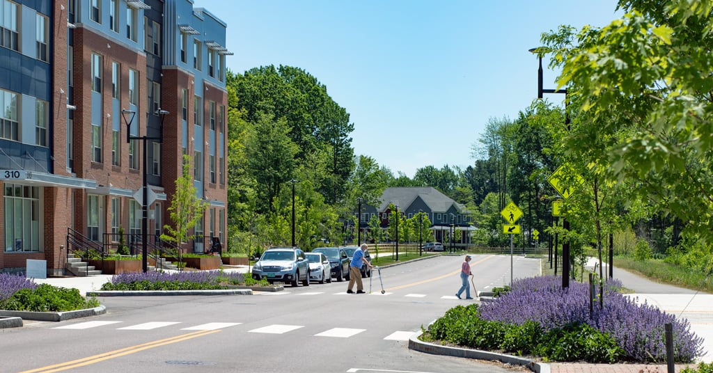
Why are we here?
1
INTRODUCTION
Notes:
Wayne

Slide 7
Committee / Group Roles
2
PROJECT OVERVIEW
Steering Committee
Stakeholder Advisory Group
Technical Working Group
VTrans PM / Senior Staff
Drive overall process
Key decision makers
VLCT, T4VT, Local Motion, VAPDA, AARP, AGC, etc.
Represents a broad cross-section of perspectives
Targeted focus on Phase 1 of the project.
VTrans Division Reps, VAPDA, ACEC
Focused on development of technical content (heavier lift in Phase 2)
Notes:
Wayne

Slide 8
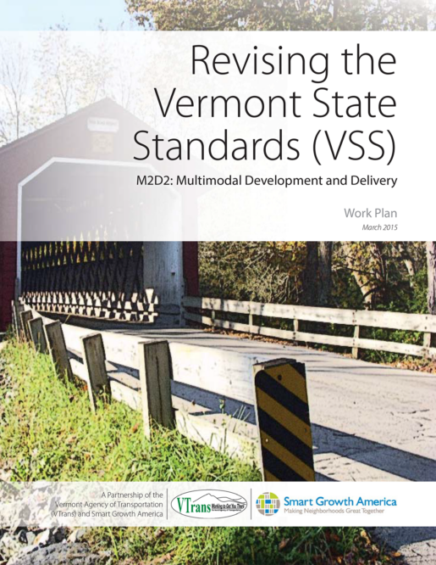
Vermont State Standards & M2D2 Background
2
PROJECT OVERVIEW
Updating these standards will help the work of the entire Agency be more efficient and more effective. The recommended revisions were informed by some of the most innovative transportation agencies in the country. This work program will help guide our design decisions as we face new challenges in the coming decades.”
Vermont State Standards (VSS)
Developed in 1997 – Established design parameters and guides for Vermont’s roadways
M2D2: Multimodal Development and Delivery
Developed in 2015 – Identifies the need for change and conceptualizes a plan to update the VSS
Notes:
Drew

Slide 9
Vermont State Standards & M2D2 Background
2
PROJECT OVERVIEW
Updating these standards will help the work of the entire Agency be more efficient and more effective. The recommended revisions were informed by some of the most innovative transportation agencies in the country. This work program will help guide our design decisions as we face new challenges in the coming decades.”
M2D2 Six Point Work Plan:
Recommended revisions to VSS
Recommended revisions to other documents, standards, guidance and procedures
Identified a proposed revision process
Discussed process for future VSS updates
Recommended approach for managing internal and external communication and collaboration
Proposed framework for conducting trainings
Notes:
Drew
Trainings are scoped for this project as part of Phase 2

Slide 10
Phase 1 Project Process
2
PROJECT OVERVIEW
PHASE 3
Implementation
Ongoing
Next Steps
Delivery
Engagement
V&G / Doc Review
Annotated Outline
SC / SAG / TWG
Occur at regular intervals, milestones
Now - December
Legislature
M2D2 Review
Ongoing
Draft Vision & Goals
Presented at SAG Meeting #2
Draft Preliminary Outline
Presented at SAG Meeting #2
VTrans Guidance Doc Review
Presented at SAG Meeting #3
Final Preliminary Outline
Presented at SAG Meeting #3
Draft Annotated Outline
Presented at SAG Meeting #4
Final Annotated Outline
Presented at SAG Meeting #5
Notes:
Rick
Meeting cadence (every 1-2 month)
Expectation: Timely review of shared materials

Slide 11
Overall Project Outcomes
3
PROJECT OUTCOMES
What our Scope and M2D2 Says: Update the Vermont State Design Standards to better reflect the goals of the VTrans Strategic Plan, current state of the practice and diverse multimodal needs of Vermont communities.
What do you need out of this document? What is working? What isn’t?
Notes:
Rick
What we are looking to get input from the group today within the upcoming breakouts is to understand the problem or challenges and what you all need out of this document. What is working for you all, what is not.
Is it project development and procedures
Is it too many documents to reference
Is it how to consider and make tradeoffs
Is it you need more case studies or examples
We’ve begun to identify some initial thoughts surrounding the purpose of this effort based on our initial discussions with the VTrans project team and reviewing the M2D2 and other documents like the VTrans Strategic Plan. We want you to begin thinking about what you need out of this document and get some thoughts generated prior to our breakout session.
Overall Project Outcome:
Update the Vermont State Design Standards to better reflect the goals of the Vtrans Strategic Plan, current state of the practice and diverse multimodal needs of Vermont communities while also:.
Developing a framework for balancing the impacts, tradeoffs and interactions of all potential travel modes
Identifying best practices for coordination between VTrans and agency partners during project development process
Providing guidance that better reflects current state of the multimodal transportation planning/engineering practice within a Vermont context
Building on work created in M2D2 document and closing identified gaps and barriers within current Vermont State Standards
Presenting guidance in a way that is accessible, contextually relevant, useful, complimentary to other state and national guidance, and updatable
Identifying other VTrans and state policies and guidance documents that need revision, consolidation, integration or discontinuing
Open it up for anything missing for topics of focus – 1 or 2 comments but note you will have opportunity to share your thoughts within your breakout groups

Slide 12
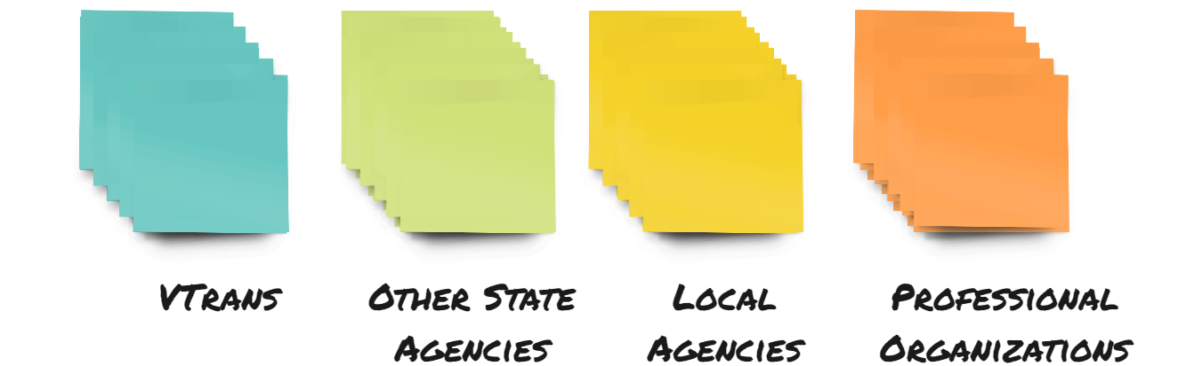
Miro Board How-To / Logistics
4
BREAKOUT GROUPS DISCUSSION
Moving around the board:
Using sticky notes and dots
Left-click and drag to move objects
Ctrl+C / Ctrl+V to copy/paste
Use the correct color!
Notes:
Laura
In a minute, we will put a link to our interactive board in the chat. Before we do, we wanted to walk you through how to move around the board and how we will rotate through activities.
EXPLANATIONS
TECH TO PUT LINK IN CHAT
Other points when we get into Miro:
How to react to people's comments
How to follow someone

Slide 13
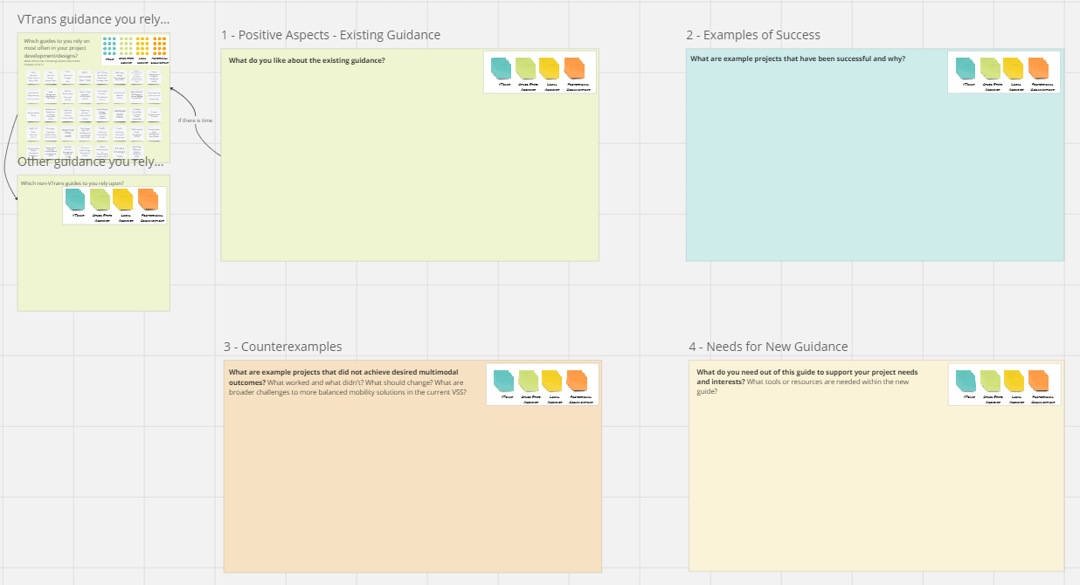
Miro Board How-To / Logistics
4
BREAKOUT GROUPS DISCUSSION
Breakout Group Rotation
Group 1
Group 2
Group 3
Group 4
Notes:
Laura
In a minute, we will put a link to our interactive board in the chat. Before we do, we wanted to walk you through how to move around the board and how we will rotate through activities.
EXPLANATIONS
TECH TO PUT LINK IN CHAT
Other points when we get into Miro:
How to react to people's comments
How to follow someone

Slide 14
What was discussed…What We Like
5
GLOBAL REPORT BACK
VSS is easy to use/navigate
Flexibility with emphasis on context sensitive design
Clear tables/figures
Road class organization
Understood to be a "primary source of guidance"
Ranges of values/more judgment to allow for great outcomes
Notes:
Bill

Slide 15
What was discussed…Great Project Outcomes
5
GLOBAL REPORT BACK
Shelburne Road/Burlington Roundabout
Montpelier road diet/bike lanes
Route 2/Danville
Creative use of materials (Cavendish, Sharon)
Middlebury Tunnel/Town Improvements
Lamoille Valley Rail Trail
West Rutland Jug Handle removal
US4 / US7 class 1 TH repaving in Rutland
Notes:
Bill

Slide 16
What was discussed…Great Project Outcomes
5
GLOBAL REPORT BACK
Strong/Early project scoping –
identify clear needs
Environmental review
Strong community engagement = strong support
Great Vtrans/Contractor/Community relationships
Corridor projects
Process improvements for delivery – statewide marking contract to reduce delivery challenges: green paint
Notes:
Bill

Slide 17
What was discussed…Projects We Wish Had Different Outcomes
5
GLOBAL REPORT BACK
Class 1 project outcomes
paving projects that don't address all the needs –
community expectations vs. Internal project delivery systems
Project limit disconnects
Design choice to match user wants (bike lanes vs off road accommodation on higher speed roads)
Berlin "rail with trail" non-railroad support hindered rail trail completion
North Ave bike lanes
MOT on I-89 work which resulted in crashes
Notes:
Bill

Slide 18
What was discussed…This Guide Needs to...
5
GLOBAL REPORT BACK
it is really challenging to navigate all the documents/policies
We need a guide to the guides/policies
Not enough thought / guidance for multimodal facilities
Disconnect between VTrans and local municipalities on what is allowed
Lack of understanding about project lifecycle and when to revisit / repermit
Notes:
Bill

Slide 19
What was discussed…This Guide Needs to...
5
GLOBAL REPORT BACK
Environmental issues not adequately scoped
Pavement management could make space for incremental change / updates but doesn’t
Gaps in bike network, especially in transitions between contexts
Notes:
Bill

Slide 20
What was discussed…This Guide Needs to...
Reiterating the need to be sensitive to context: "context" means landuse/project delivery method/funding sources!
Common language that makes the guide easy to navigate and share with communities
Guidance for multimodal accommodations and shared spaces
Guidance for placemaking
Guidance for environmental constraints
Plan to manage this document so it is kept up to date and easy to update
Assess LOS policies related to project delivery outcomes/Safe Systems goals

Slide 21
Where are we heading from here?
6
Next Steps
Develop Draft Vision & Goals Statement
Draft Preliminary Guide Outline
Review Guidance from other States / Municipalities
Review VT State Documents
June – July 2024
June – July 2024
August – September 2024
August – September 2024
Notes:
Drew

Slide 22
Stay in touch
Kara Yelinek
Wayne Symonds
Project Manager
Project Manager
Kara.Yelinek@vermont.gov
wsymonds@vhb.com
802.595.4655
802.497.6105

